Slide 1

6.874, 6.802, 20.390, 20.490, HST.506 Computational Systems Biology
Deep Learning in the Life Sciences
Lecture 3: Convolutional Neural Networks
Prof. Manolis Kellis
Slides credit: 6.S191, Dana Erlich, Param Vir Singh, David Gifford, Alexander Amini, Ava Soleimany
http://mit6874.github.io

Slide 2
Today: Convolutional Neural Networks (CNNs)
Scene understanding and object recognition for machines (and humans)
Scene/object recognition challenge. Illusions reveal primitives, conflicting info
Human neurons/circuits. Visual cortex layers==abstraction. General cognition
Classical machine vision foundations: features, scenes, filters, convolution
Spatial structure primitives: edge detectors & other filters, feature recognition
Convolution: basics, padding, stride, object recognition, architectures
CNN foundations: LeNet, de novo feature learning, parameter sharing
Key ideas: learn features, hierarchy, re-use parameters, back-prop filter learning
CNN formalization: representations(Conv+ReLU+Pool)*N layers + Fully-connected
Modern CNN architectures: millions of parameters, dozens of layers
Feature invariance is hard: apply perturbations, learn for each variation
ImageNet progression of best performers
AlexNet: First top performer CNN, 60M parameters (from 60k in LeNet-5), ReLU
VGGNet: simpler but deeper (8→19 layers), 140M parameters, ensembles
GoogleNet: new primitive=inception module, 5M params, no FC, efficiency
ResNet: 152 layers, vanishing gradients ➔ fit residuals to enable learning
Countless applications: General architecture, enormous power
Semantic segmentation, facial detection/recognition, self-driving, image colorization, optimizing pictures/scenes, up-scaling, medicine, biology, genomics

Slide 3
1a. What do you see, and how? Can we teach machines to see?

Slide 4
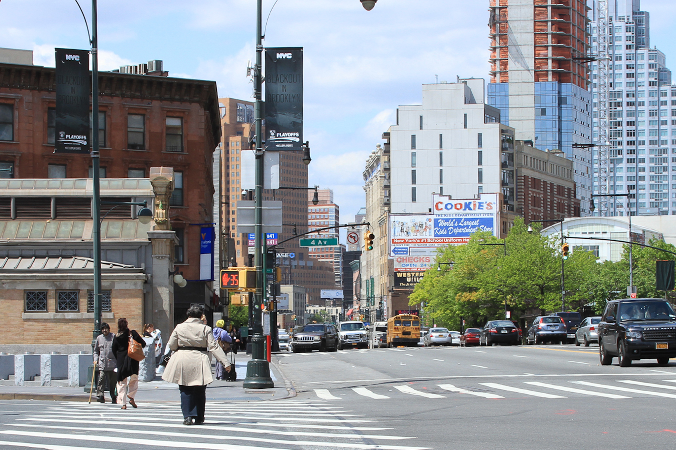
What do you see?

Slide 5
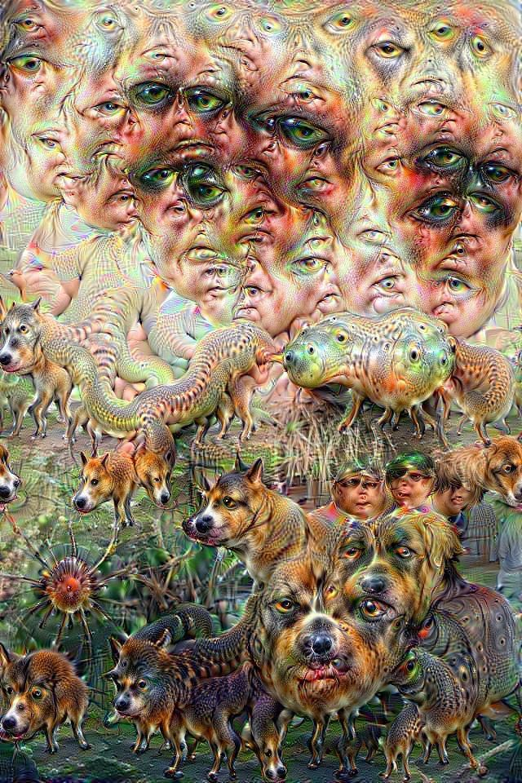
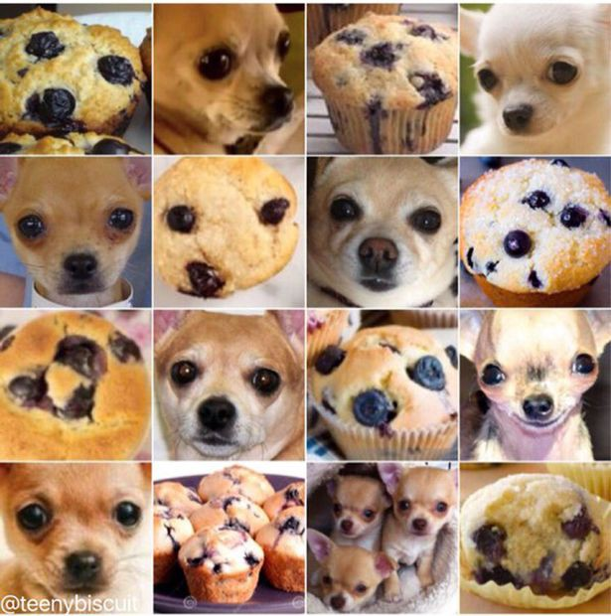
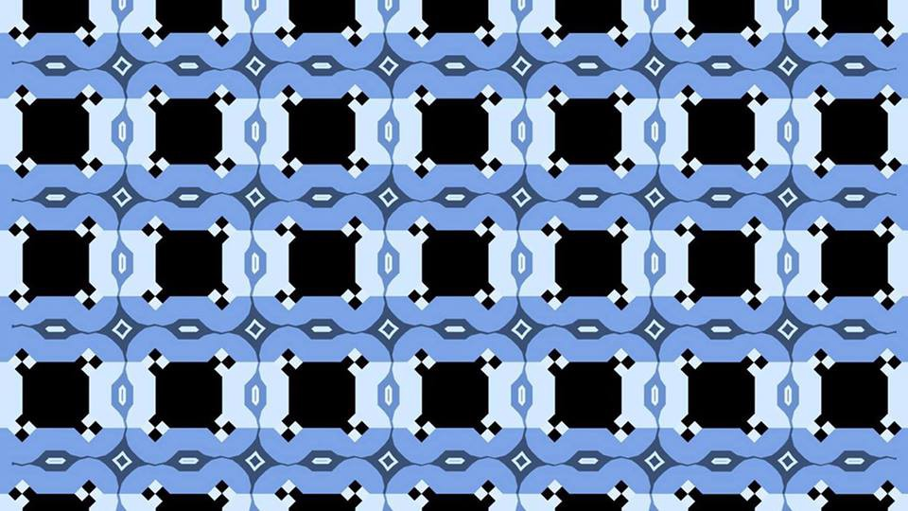
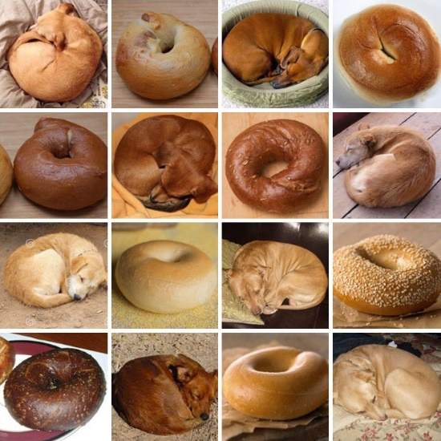
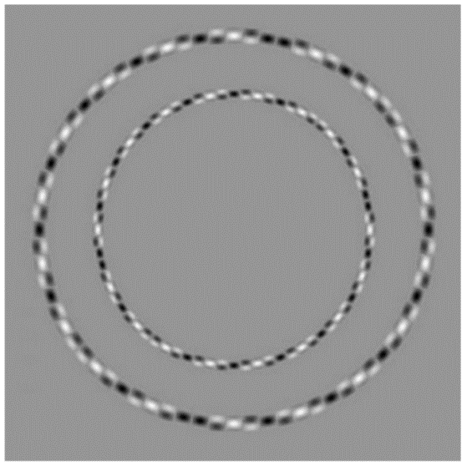
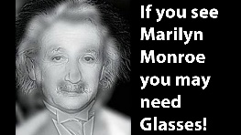
How do you see?
How can we help computers see?

Slide 6

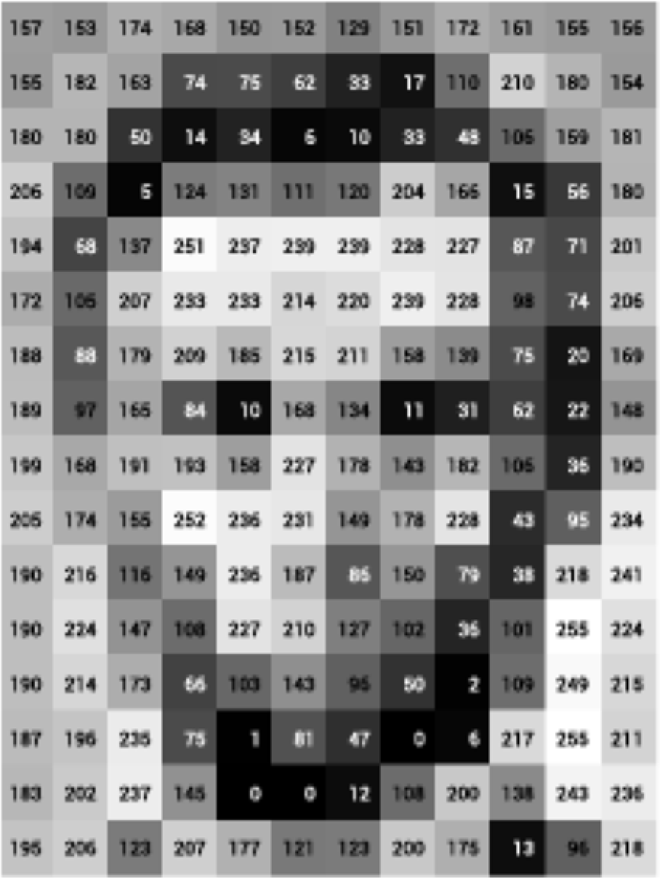
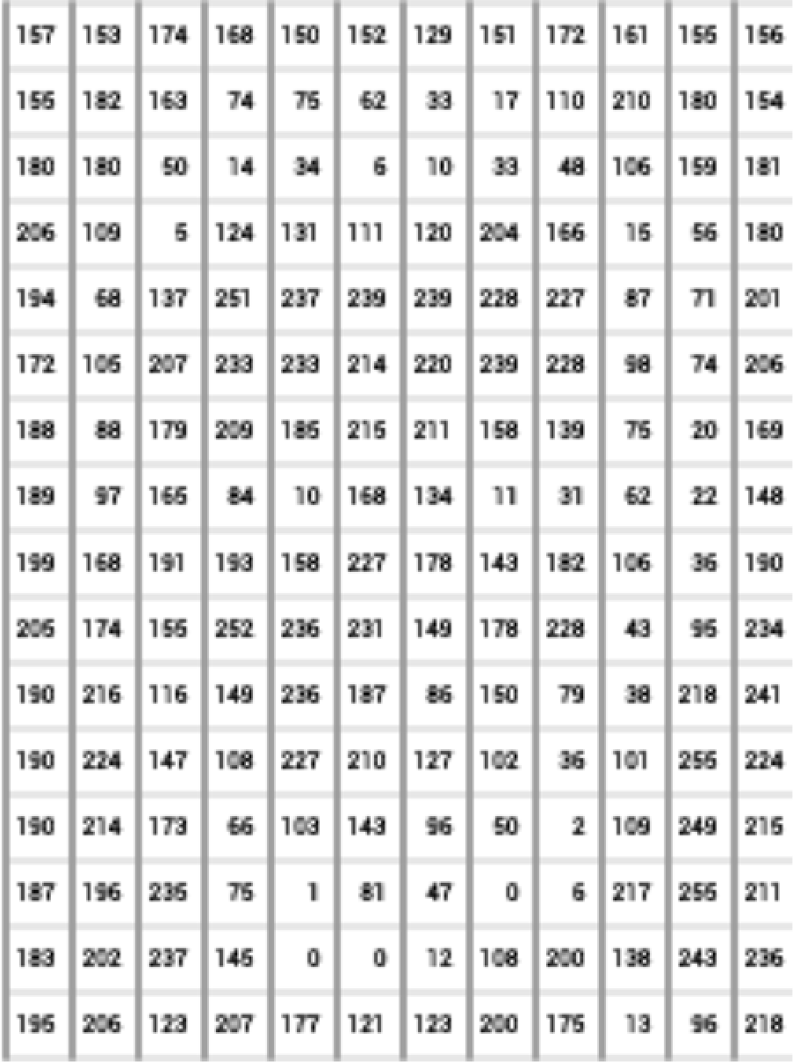
What computers ‘see’: Images as Numbers
What you see
What you both see
What the computer "sees"
Levin Image Processing & Computer Vision
Input Image
Input Image + values
Pixel intensity values
(“pix-el”=picture-element)
An image is just a matrix of numbers [0,255]. i.e., 1080x1080x3 for an RGB image.
Question: is this Lincoln? Washington? Jefferson? Obama?
How can the computer answer this question?
Can I just do classification on the 1,166400-long image vector directly?
No. Instead: exploit image spatial structure. Learn patches. Build them up

Slide 7
1b. Classical machine vision roots in study of human/animal brains

Slide 8
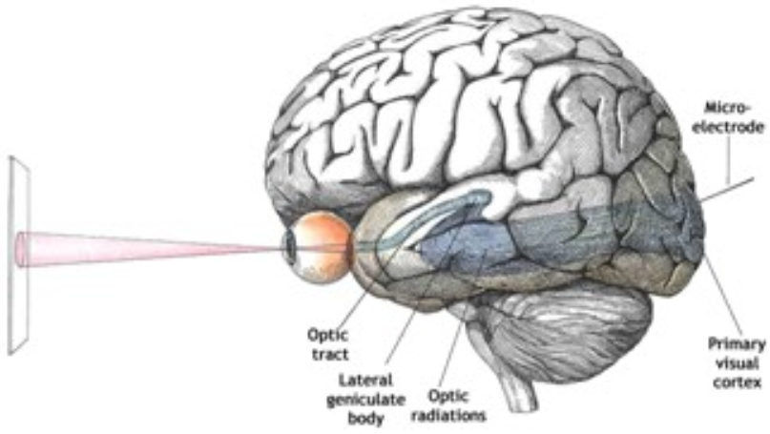
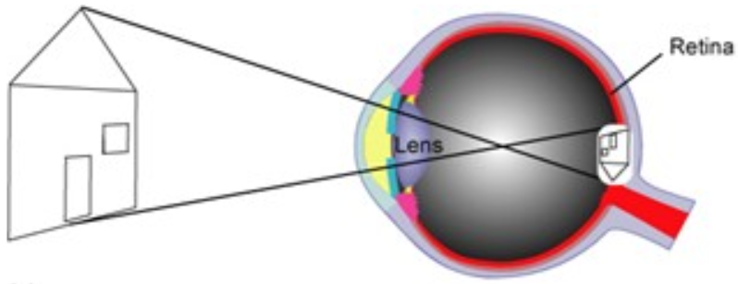
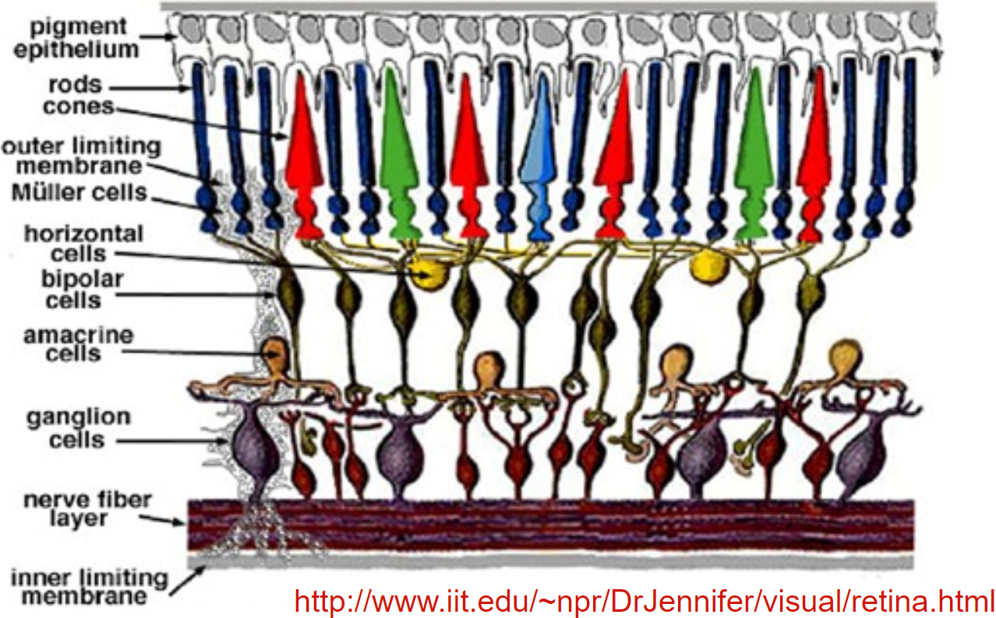
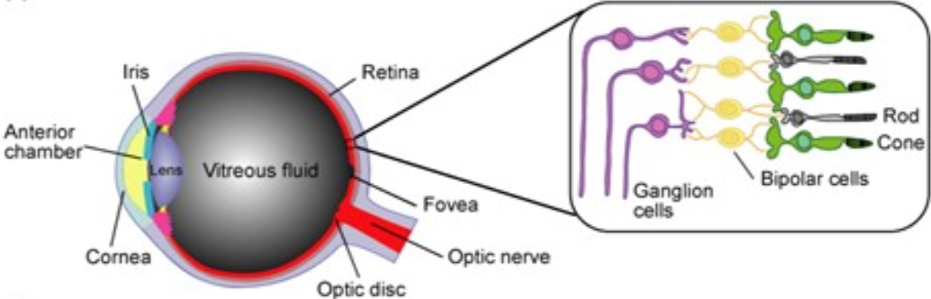
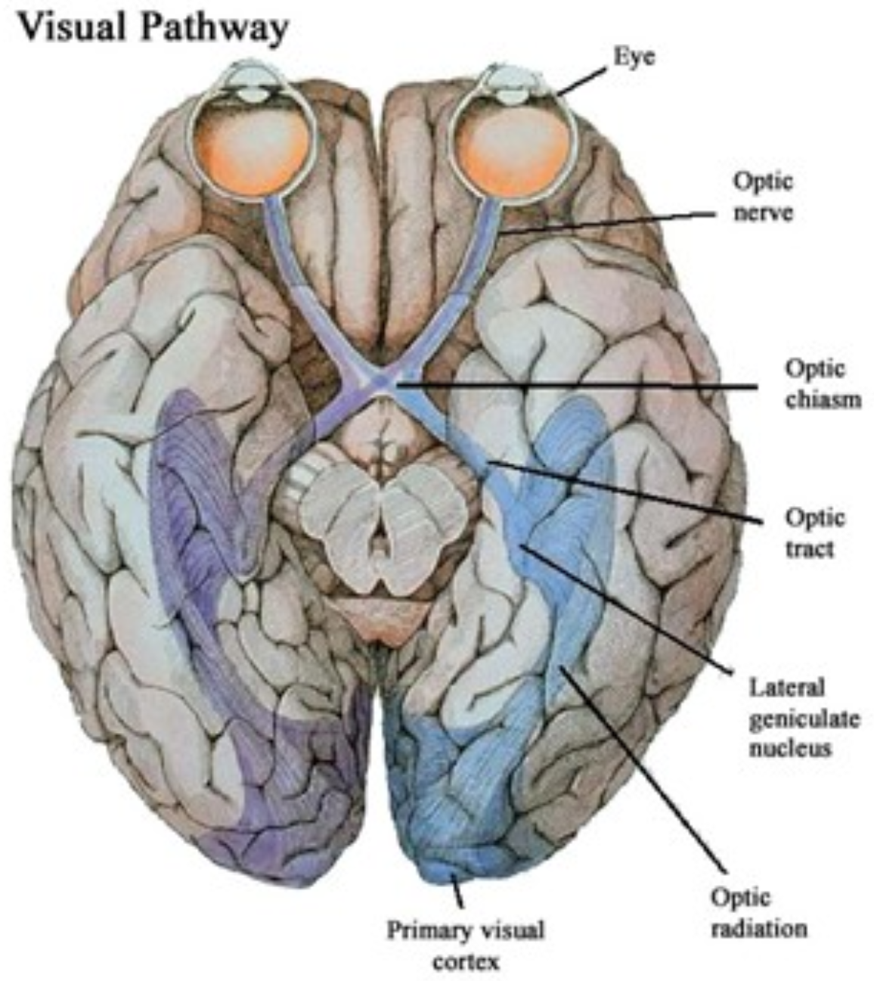
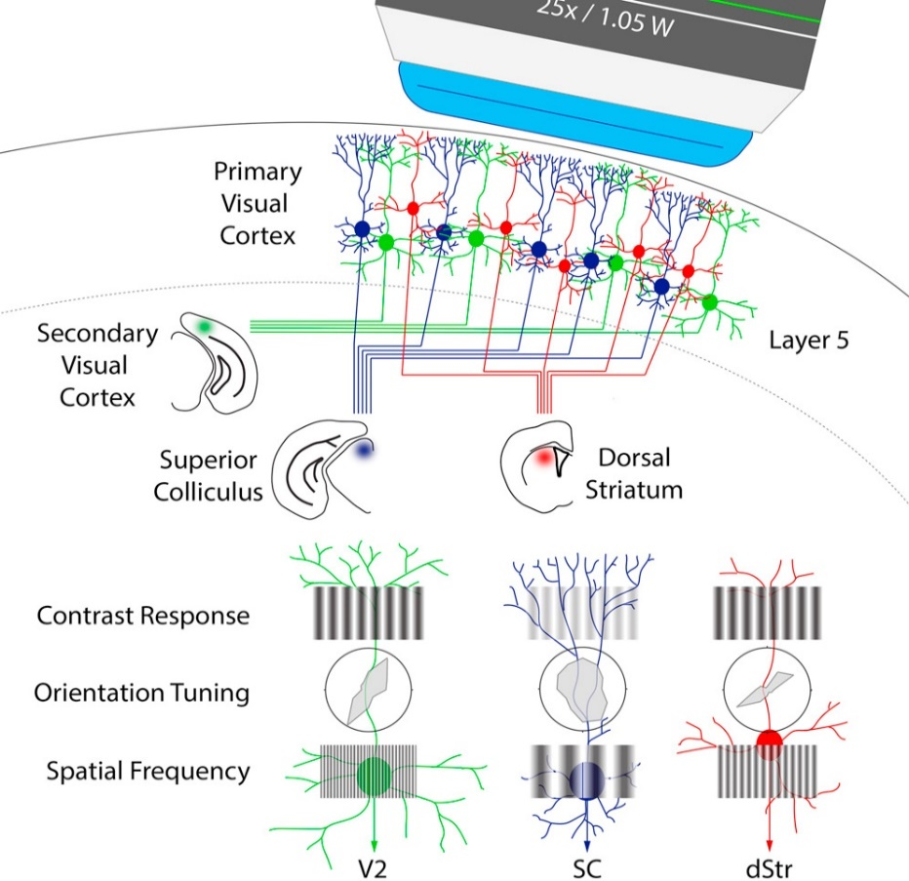
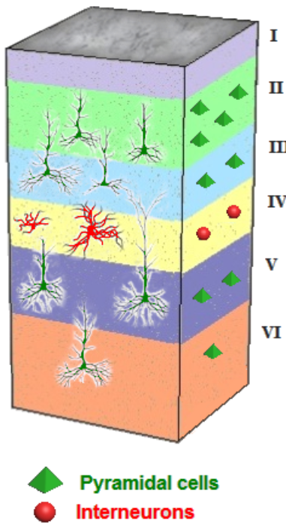
Inspiration: human/animal visual cortex
Layers of neurons: pixels, edges, shapes, primitives, scenes
E.g. Layer 4 responds to bands w/ given slant, contrasting edges

Slide 9
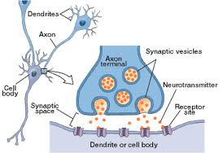
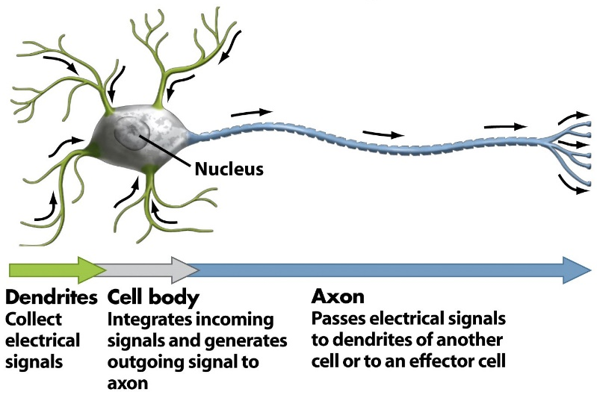
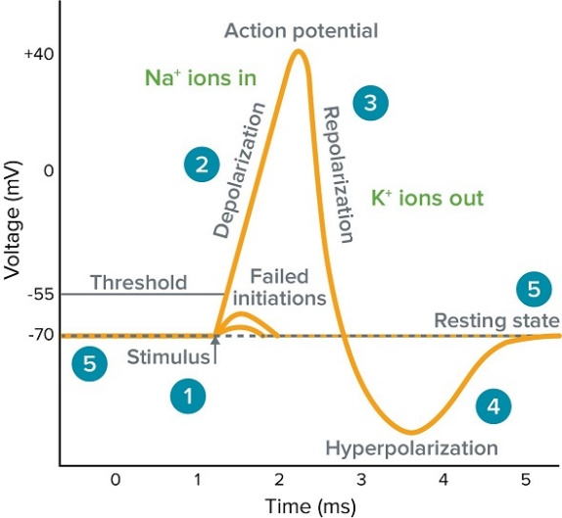
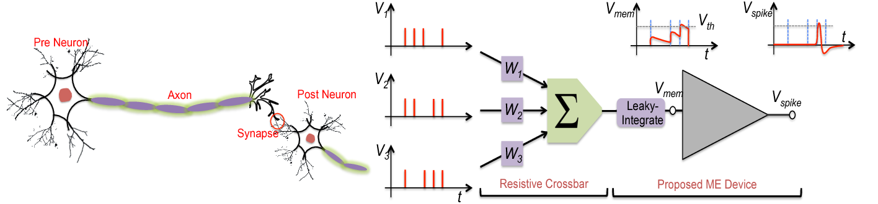
Primitives: Neurons & action potentials
Chemical accumulation across dendritic connections
Pre-synaptic axon → post-synaptic dendrite → neuronal cell body
Each neuron receives multiple signals from its many dendrites
When threshold crossed, it fires
Its axon then sends outgoing signal to downstream neurons
Weak stimuli ignored
Sufficiently strong cross activation threshold
Non-linearity within each neuronal level
Neurons connected into circuits (neural networks): emergent properties, learning, memory
Simple primitives arranged in simple, repetitive, and extremely large networks
86 billion neurons, each connects to 10k neurons, 1 quadrillion (10¹²) connections

Slide 10
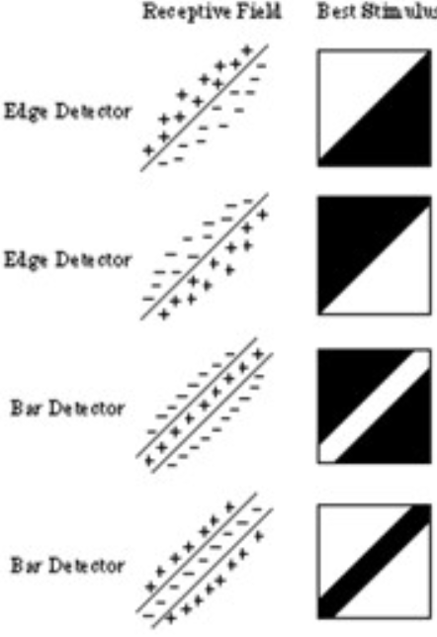
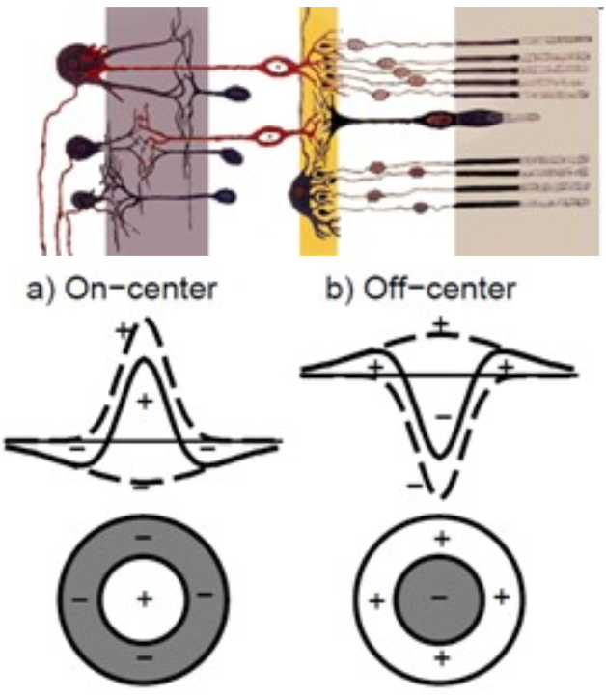
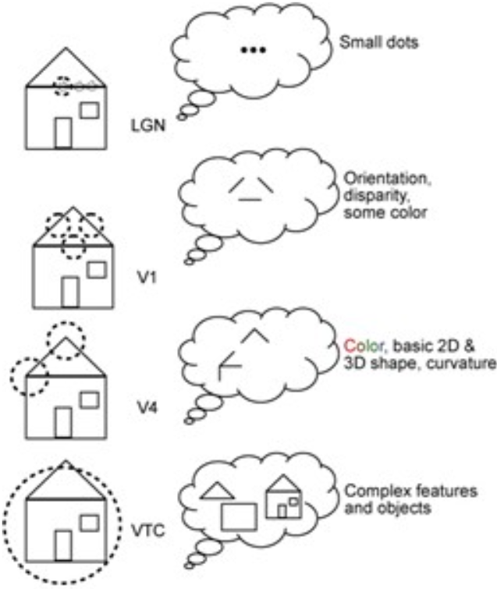
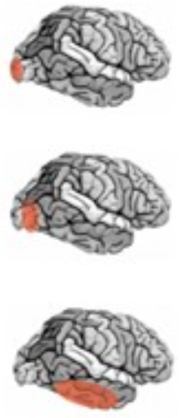
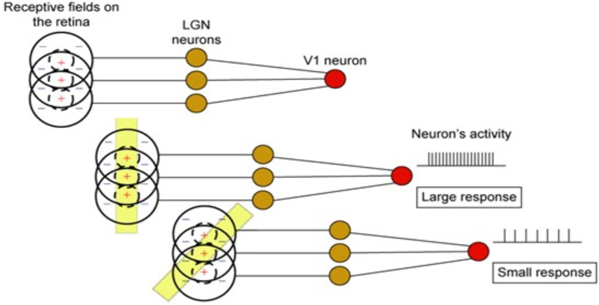
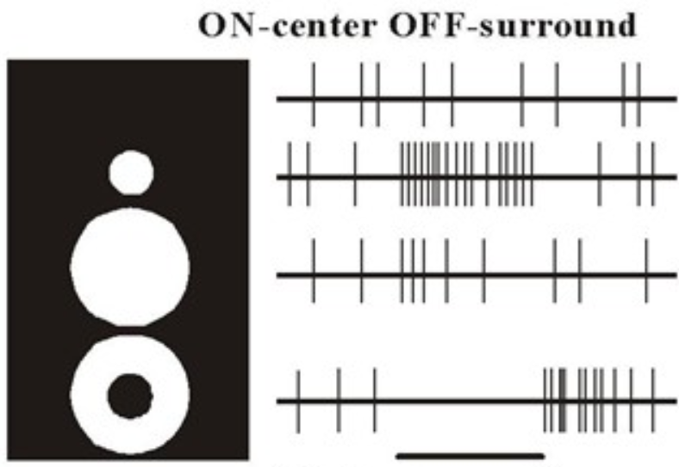
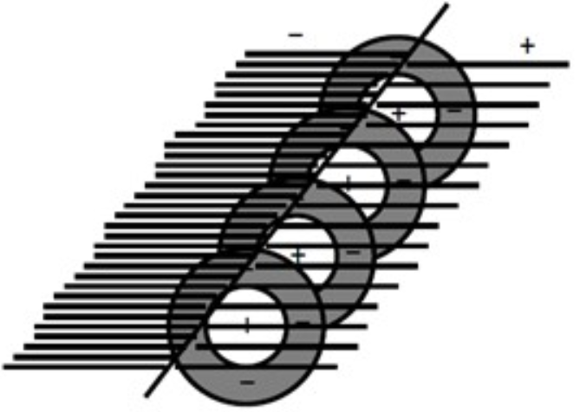
Abstraction layers: edges, bars, dir., shapes, objects, scenes
LGN: Small dots
V1: Orientation, disparity, some color
V4: Color, basic shapes,
2D/3D, curvature
VTC: Complex features and objects (VTC: ventral temporal cortex)
Primitives of visual concepts encoded in neuronal connection in early cortical layers
Abstraction layers ⬄ visual cortex layers
Complex concepts from simple parts, hierarchy

Slide 11
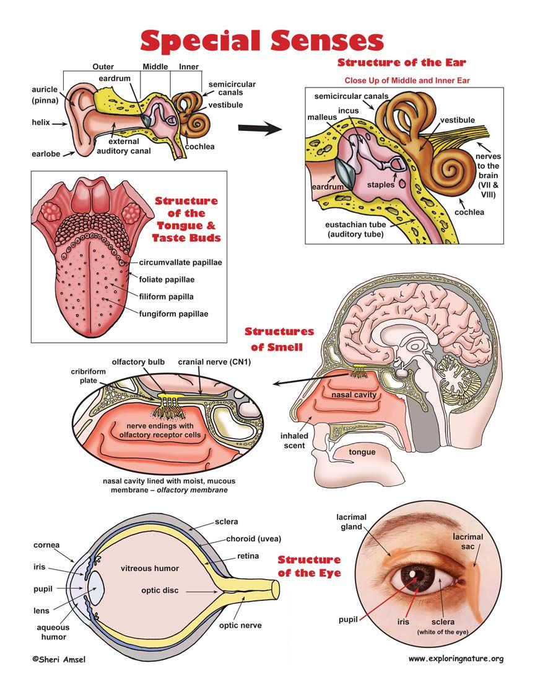
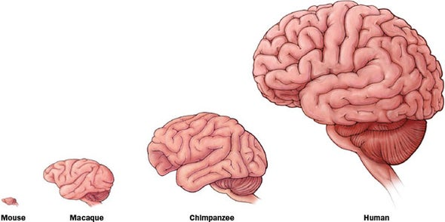
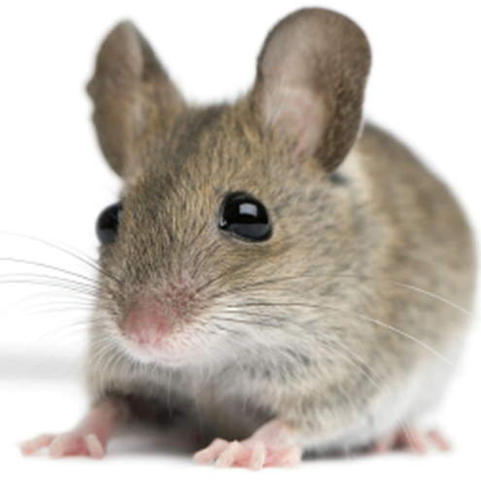
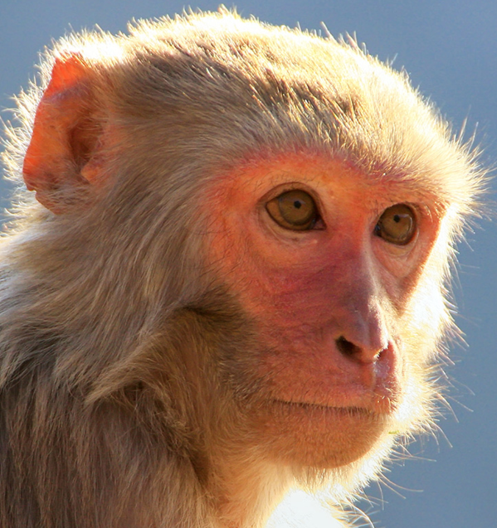
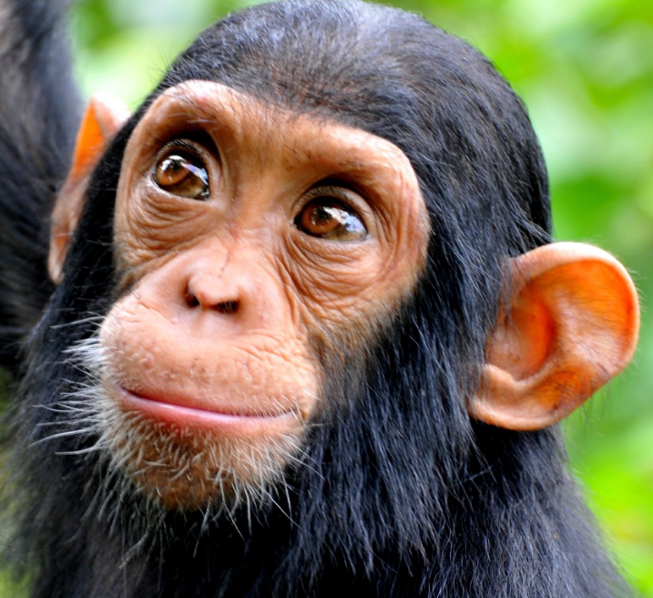

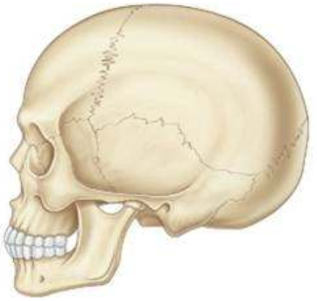
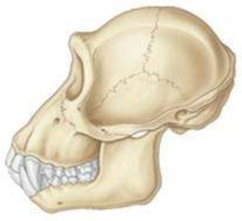

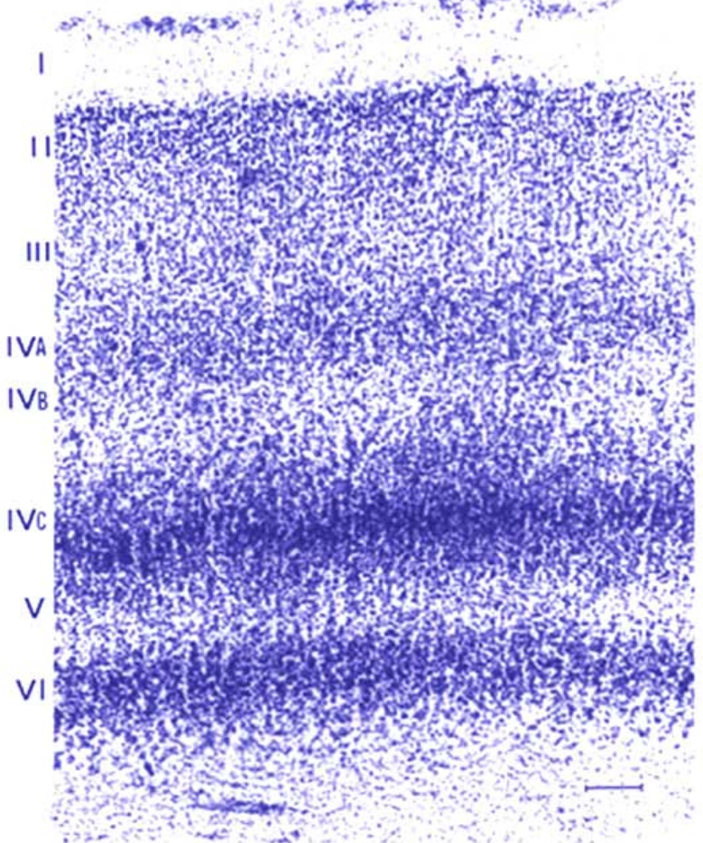
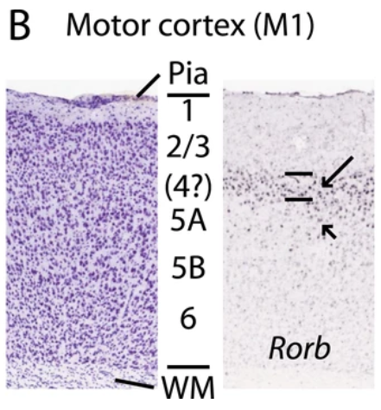
General “learning machine”, reused widely
Hardware
expansion
chimp
human
Massive recent expanse of human brain has re-used a relatively simple but general learning architecture
Hearing, taste, smell, sight, touch all re-use similar learning architecture
Visual Cortex
Motor Cortex
Interchangeable circuitry
Auditory cortex learns to ‘see’ if sent visual signals
Injury area tasks shift to uninjured areas
Not fully-general learning, but well-adapted to our world
Humans co-opted this circuitry to many new applications
Modern tasks accessible to any homo sapiens (<70k years)
ML primitives not too different from animals: more to come?

Slide 12
Today: Convolutional Neural Networks (CNNs)
Scene understanding and object recognition for machines (and humans)
Scene/object recognition challenge. Illusions reveal primitives, conflicting info
Human neurons/circuits. Visual cortex layers==abstraction. General cognition
Classical machine vision foundations: features, scenes, filters, convolution
Spatial structure primitives: edge detectors & other filters, feature recognition
Convolution: basics, padding, stride, object recognition, architectures
CNN foundations: LeNet, de novo feature learning, parameter sharing
Key ideas: learn features, hierarchy, re-use parameters, back-prop filter learning
CNN formalization: representations(Conv+ReLU+Pool)*N layers + Fully-connected
Modern CNN architectures: millions of parameters, dozens of layers
Feature invariance is hard: apply perturbations, learn for each variation
ImageNet progression of best performers
AlexNet: First top performer CNN, 60M parameters (from 60k in LeNet-5), ReLU
VGGNet: simpler but deeper (8→19 layers), 140M parameters, ensembles
GoogleNet: new primitive=inception module, 5M params, no FC, efficiency
ResNet: 152 layers, vanishing gradients ➔ fit residuals to enable learning
Countless applications: General architecture, enormous power
Semantic segmentation, facial detection/recognition, self-driving, image colorization, optimizing pictures/scenes, up-scaling, medicine, biology, genomics

Slide 13
2a. Spatial structure for image recognition

Slide 14
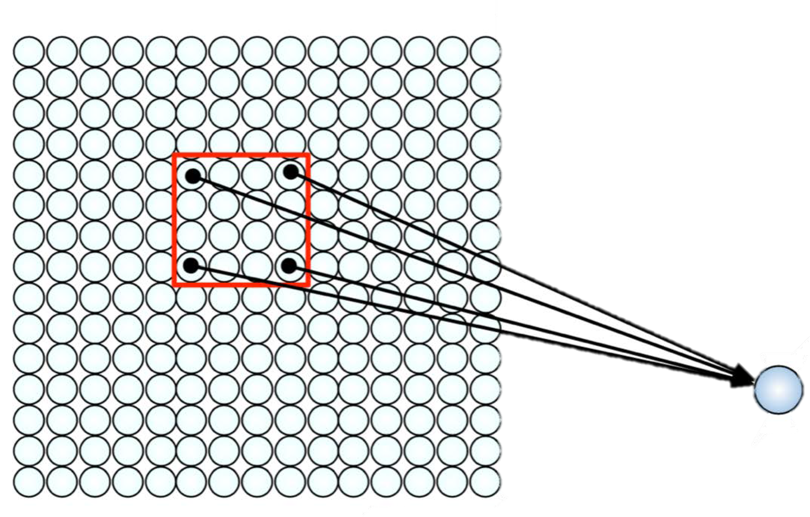
Using Spatial Structure
Input: 2D image.
Array of pixel values
Idea: connect patches of input to neurons in hidden layer.
Neuron connected to region of input. Only “sees” these values.

Slide 15
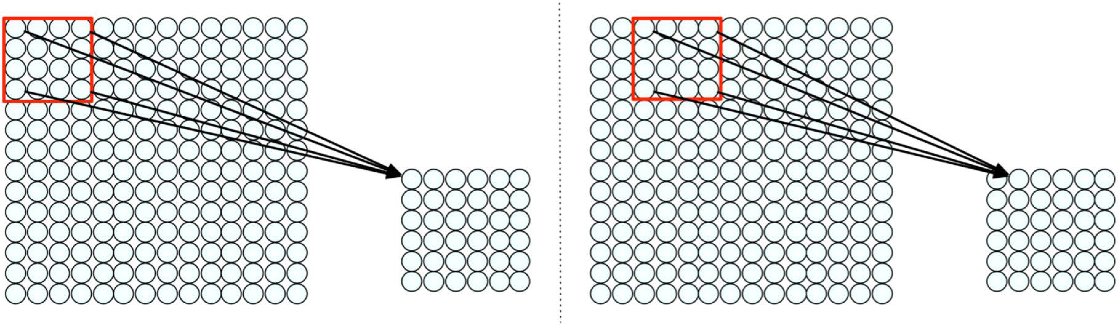
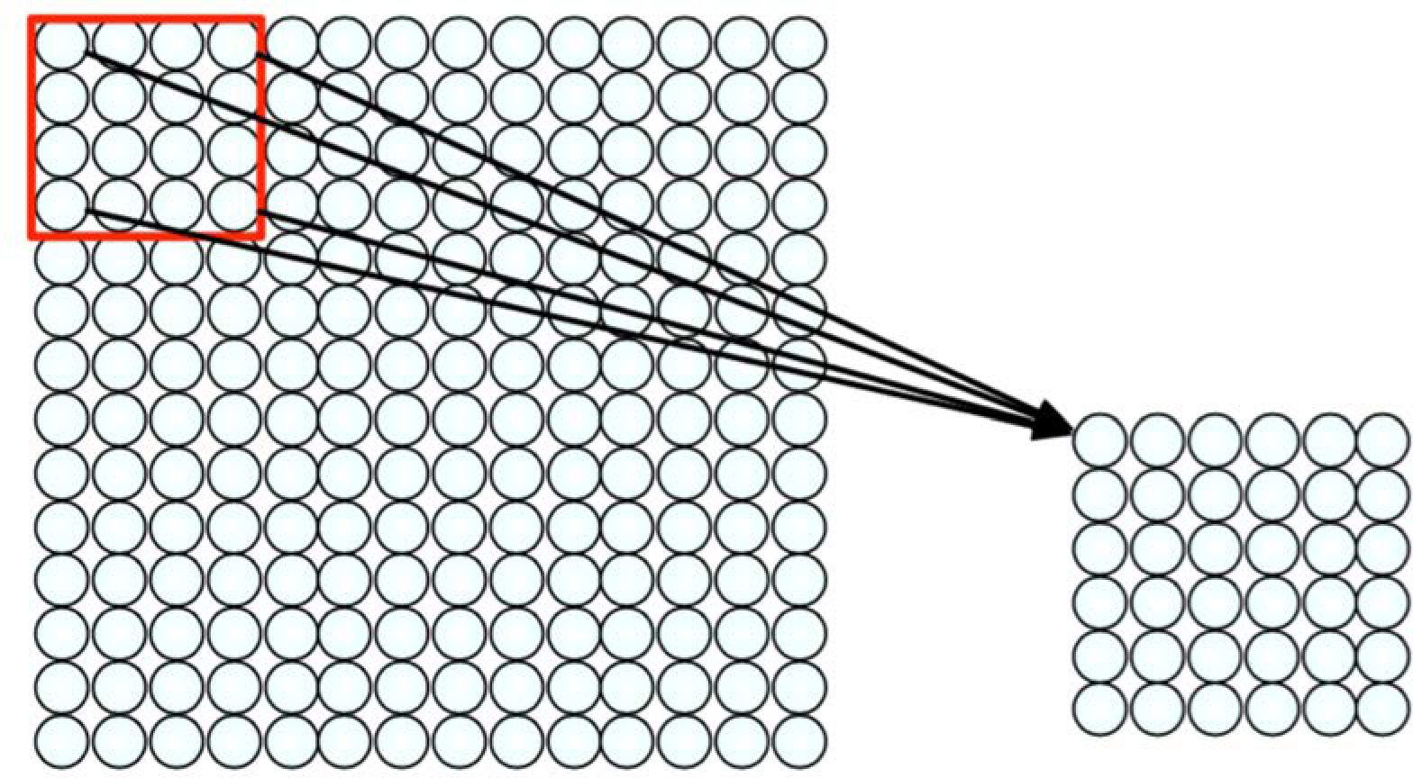
Using Spatial Structure
Connect patch in input layer to a single neuron in subsequent layer.
Use a sliding window to define connections.
How can we weight the patch to detect particular features?

Slide 16
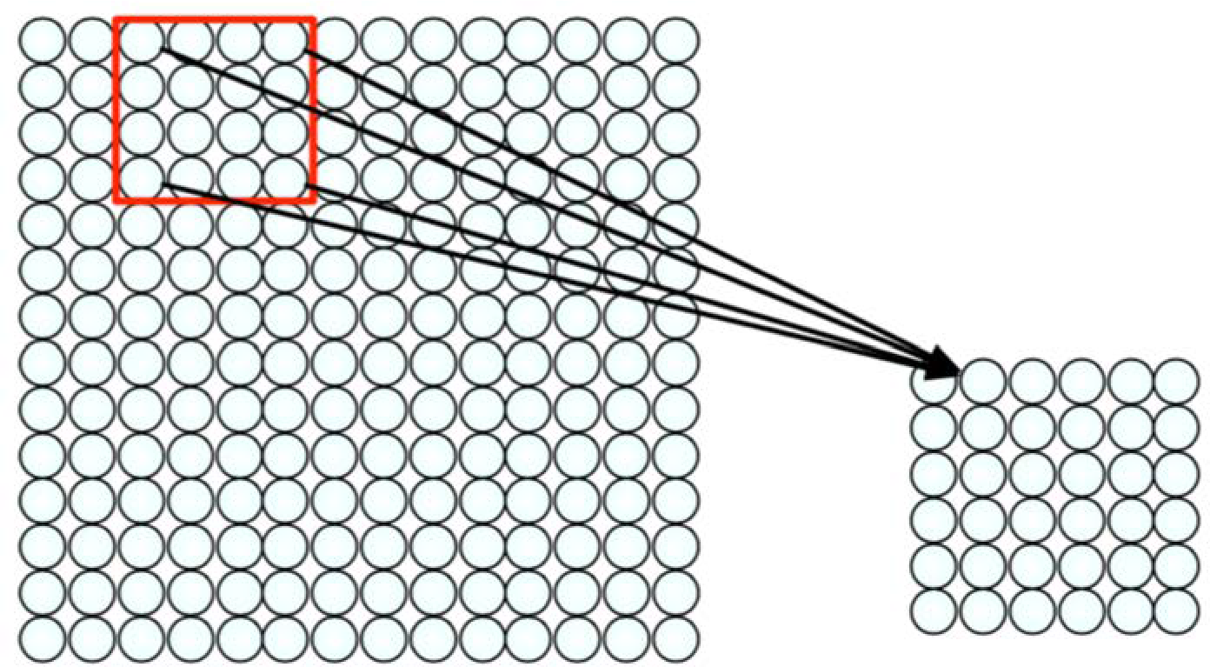
Feature Extraction with Convolution
Filter of size 4x4 : 16 different weights
Apply this same filter to 4x4 patches in input
Shift by 2 pixels for next patch
This “patchy” operation is convolution
Apply a set of weights – a filter – to extract local features
Use multiple filters to extract different features
Spatially share parameters of each filter

Slide 17
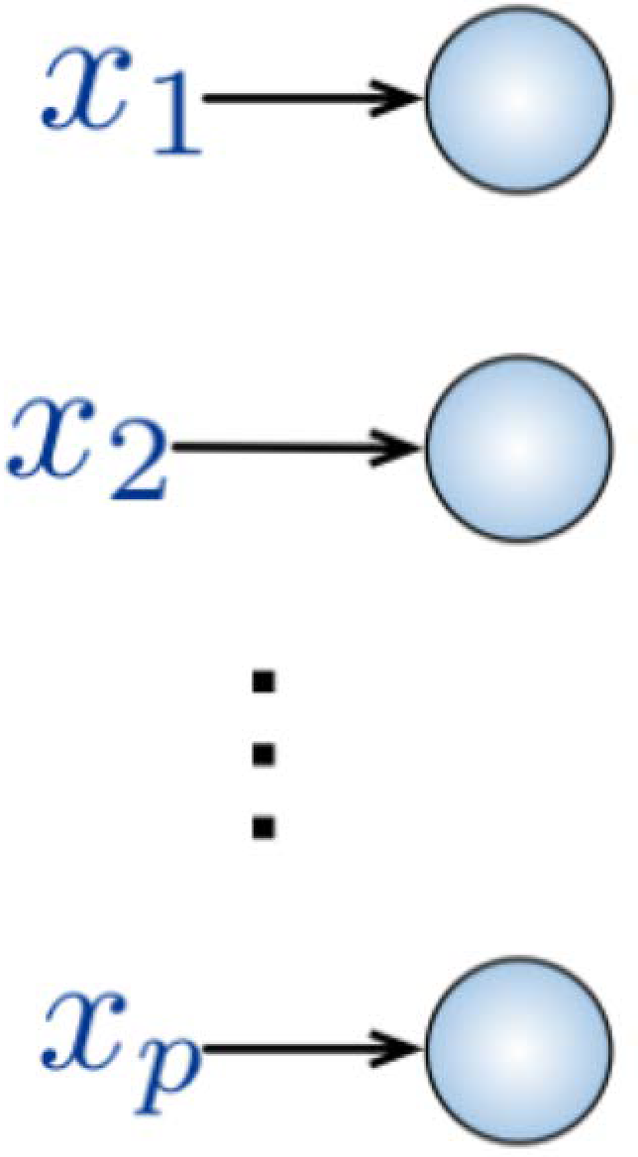
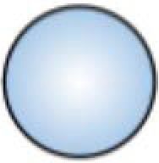
Fully Connected Neural Network
Input:
2D image
Vector of pixel values
Fully Connected:
Each neuron in hidden layer connected to all neurons in input layer
No spatial information
Many, many parameters
Key idea: Use spatial structure in input to inform architecture of the network

Slide 18
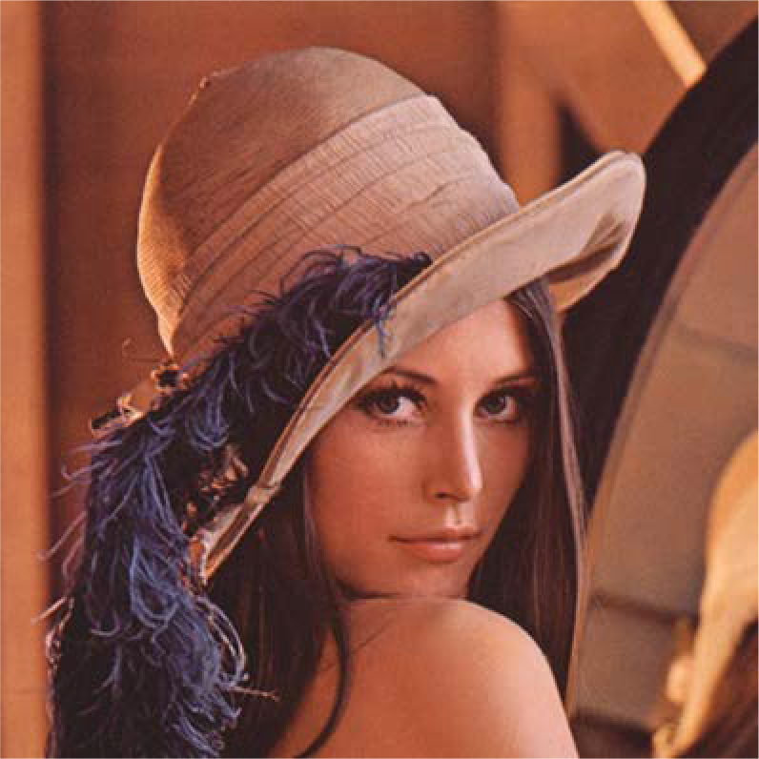
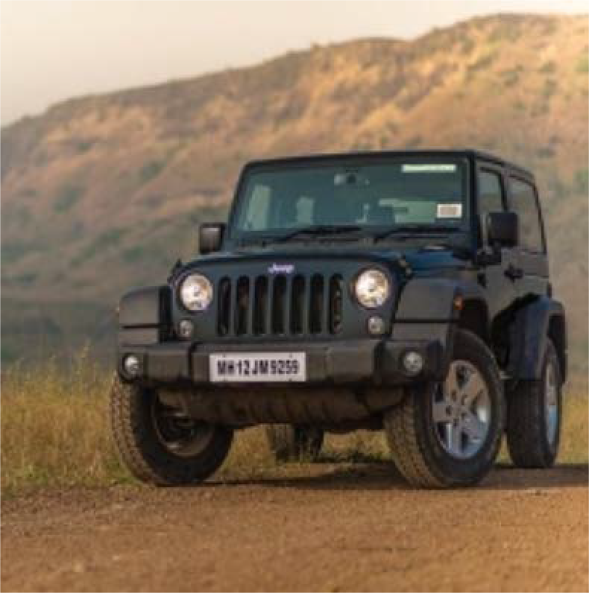
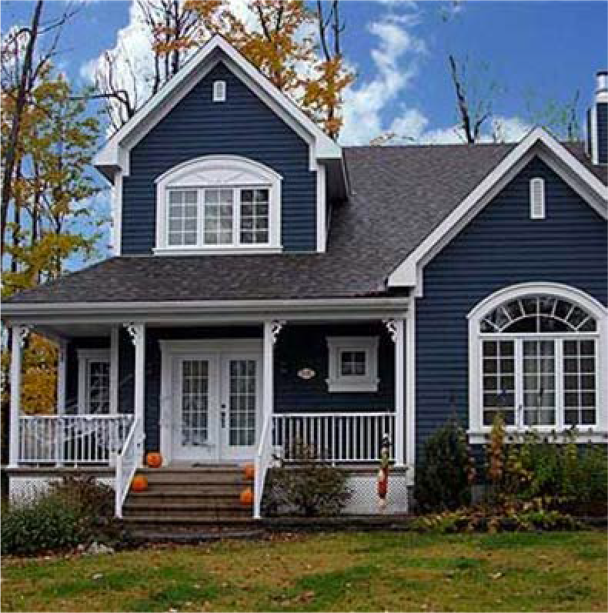
High Level Feature Detection
Let’s identify key features in each image category
Nose, Eyes, Mouth
Wheels, License Plate, Headlights
Door, Windows, Steps

Slide 19
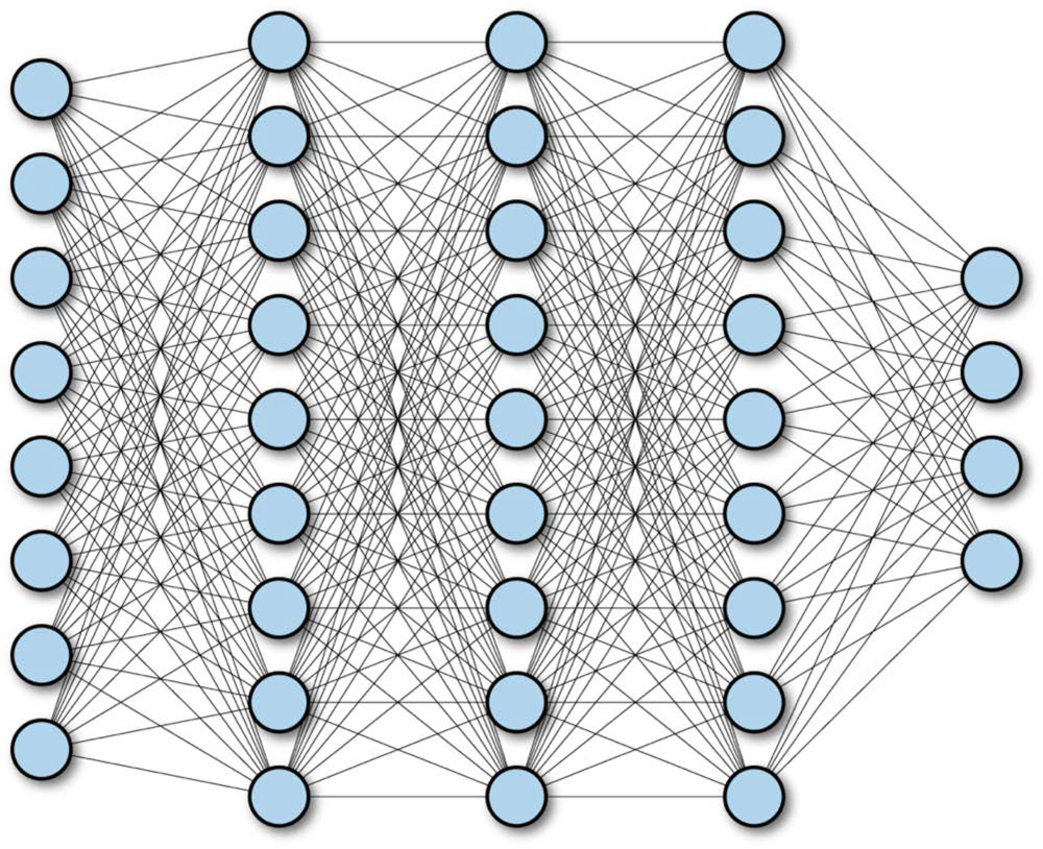
Fully Connected Neural Network

Slide 20
2b. Convolutions and filters

Slide 21

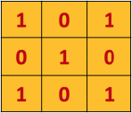
Convolution operation is element wise multiply and add
Filter / Kernel

Slide 22
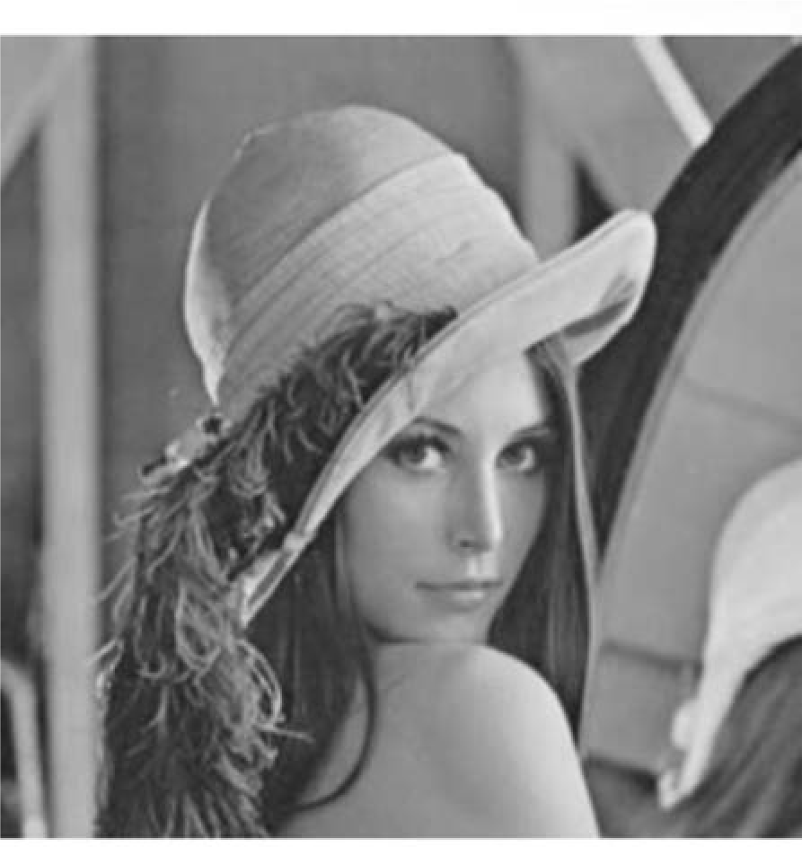
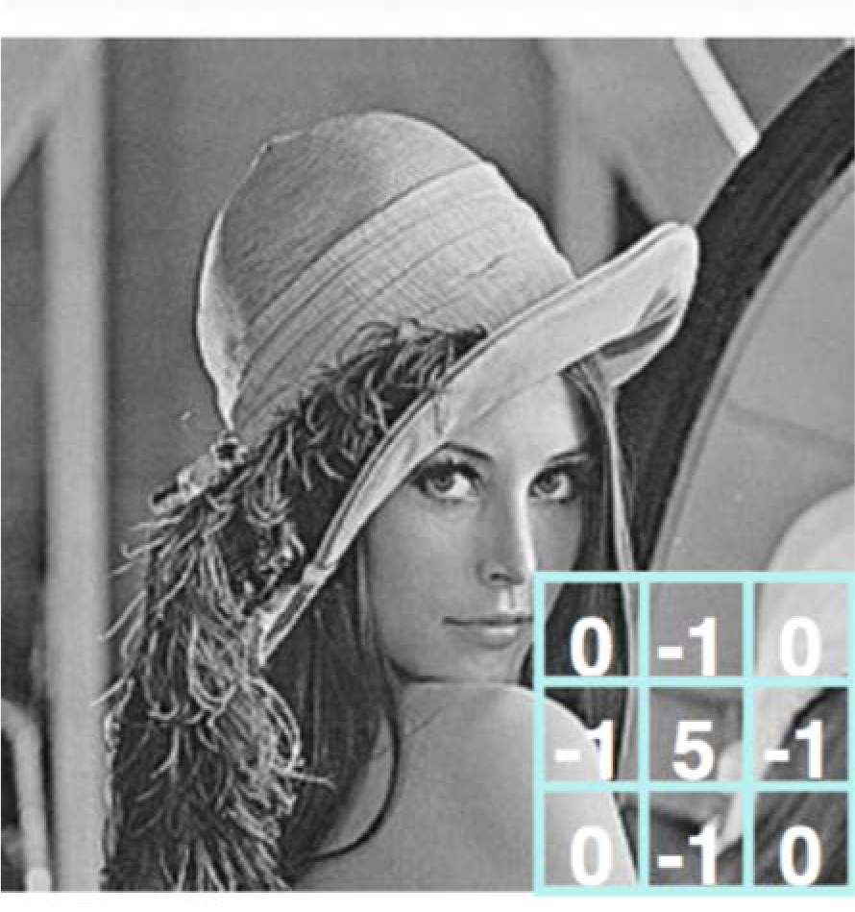
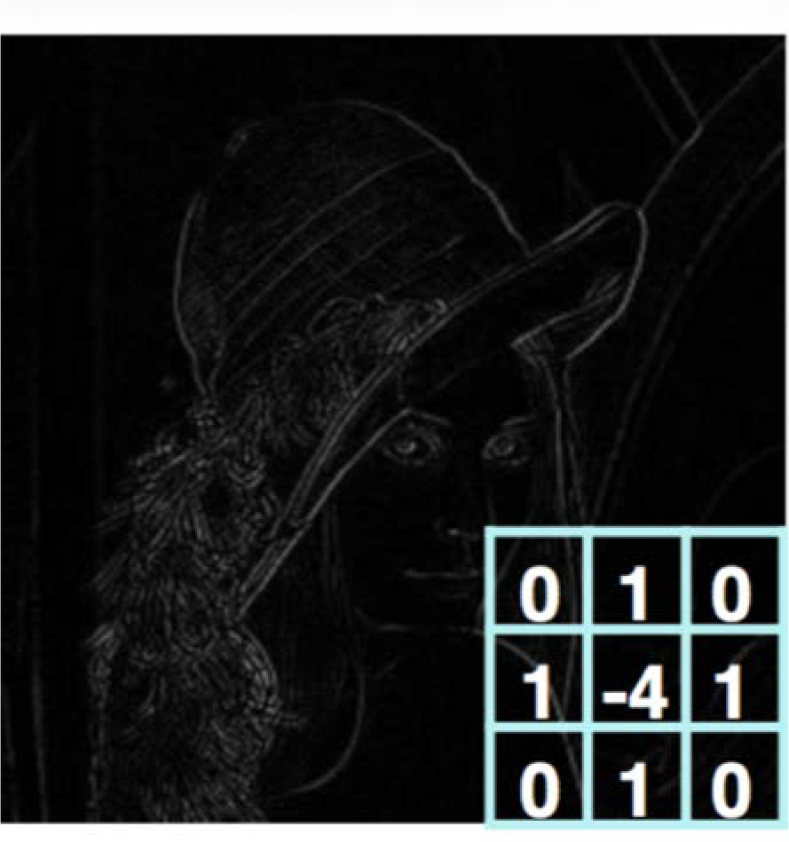

Producing Feature Maps
Original
Sharpen
Edge Detect
“Strong” Edge Detect

Slide 23

A simple pattern: Edges
How can we detect edges with a kernel?
Input
-1 -1
Output
Filter
(Goodfellow 2016)

Slide 24

Simple Kernels / Filters

Slide 25

X or X?
Image is represented as matrix of pixel values… and computers are literal!
We want to be able to classify an X as an X even if it’s shifted, shrunk, rotated, deformed.
Rohrer How do CNNs work?

Slide 26

There are three approaches to edge cases in convolution

Slide 27



Zero Padding Controls Output Size
(Goodfellow 2016)
• Same convolution: zero pad input so output is same size as input dimensions
• Valid-only convolution: output only when entire kernel contained in input (shrinks output)
• Full convolution: zero pad input so output is produced whenever an output value contains at least one input value (expands output)
x = tf.nn.conv2d(x, W, strides=[1,strides,strides,1],padding='SAME')
TF convolution operator takes stride and zero fill option as parameters
Stride is distance between kernel applications in each dimension
Padding can be SAME or VALID

Slide 29
Today: Convolutional Neural Networks (CNNs)
Scene understanding and object recognition for machines (and humans)
Scene/object recognition challenge. Illusions reveal primitives, conflicting info
Human neurons/circuits. Visual cortex layers==abstraction. General cognition
Classical machine vision foundations: features, scenes, filters, convolution
Spatial structure primitives: edge detectors & other filters, feature recognition
Convolution: basics, padding, stride, object recognition, architectures
CNN foundations: LeNet, de novo feature learning, parameter sharing
Key ideas: learn features, hierarchy, re-use parameters, back-prop filter learning
CNN formalization: representations(Conv+ReLU+Pool)*N layers + Fully-connected
Modern CNN architectures: millions of parameters, dozens of layers
Feature invariance is hard: apply perturbations, learn for each variation
ImageNet progression of best performers
AlexNet: First top performer CNN, 60M parameters (from 60k in LeNet-5), ReLU
VGGNet: simpler but deeper (8→19 layers), 140M parameters, ensembles
GoogleNet: new primitive=inception module, 5M params, no FC, efficiency
ResNet: 152 layers, vanishing gradients ➔ fit residuals to enable learning
Countless applications: General architecture, enormous power
Semantic segmentation, facial detection/recognition, self-driving, image colorization, optimizing pictures/scenes, up-scaling, medicine, biology, genomics

Slide 30
3a. Learning Visual Features de novo

Slide 31



Key idea: learn hierarchy of features directly from the data (rather than hand-engineering them)
Low level features Mid level features High level features
Edges, dark spots
Eyes, ears, nose
Facial structure
Lee+ ICML 2009

Slide 32

Key idea: re-use parameters Convolution shares parameters Example 3x3 convolution on a 5x5 image

Slide 33

Feature Extraction with Convolution
Apply a set of weights – a filter – to extract local features
Use multiple filters to extract different features
Spatially share parameters of each filter

Slide 34

LeNet-5
Gradient Based Learning Applied To Document Recognition - Y. Lecun, L. Bottou, Y. Bengio, P. Haffner; 1998
Helped establish how we use CNNs today
Replaced manual feature extraction
[LeCun et al., 1998]
Notes:
Article writer - Jan LeCun - who is today the director of A.I. Facebook helped establish the way we use CNNs today - as a multilayered structure of neurons for the processing of complex phases in the deep layers of the network.
The features of CNNs differ from those of traditional feed-forward networks in several aspects, making them effective for the needs of vision problems.
For example, images are represented by height and depth so that depth refers to the number of channels per pixel. Example 3 - R, G, B. If we used a traditional fully connected structure, we would get a significant increase in the number of parameters and that would result in overfitting. (For a 670x1040 image, we would get more than 2 million parameters already in the first layer)
CNNs lower the number of parameters by allowing different parts of the network to focus on high-level features like texture or repetitive examples.
In the article, Lacon notes that because CNNs learn all the weights alone through backpropagation, it can be seen as if CNNs make their own features. Until this realization of Lacon, work was done with networks in the field of vision, but feature extraction was done as a form of preprocessing.
כותב המאמר – יאן לקון – שהיום הוא הdirector of A.I. בFacebook עזר לבסס את הדרך שבה אנחנו משתמשים ב CNNs היום – כמבנה רב שכבתי של נוירונים לטובת עיבוד של פ'יצרים מורכבים, בשכבות העמוקות של הרשת.
התכונות של CNNs שונות מאלו של רשתות feed-forward מסורתיות הכמה היבטים, וגורמות להם להיות אפקטיביות לצרכים של בעיות ראיה.
למשל תמונות מיוצגות על ידי גובה רוחב ועומק כך שעומק מתייחס למספר הchannels בכל פיקסל. למשל 3 – R,G,B. אם היינו משתמשים במבנה מסורתי fully connected, היינו מקבלים עליה משמעותית במספר הפרמטרים וזה היה מביא לoverfitting. (עבור תמונה 670x1040 היינו מקבלים יותר מ 2 מיליון פרמטרים כבר בשכבה הראשונה)
CNNs מורידים את מספר הפרמטרים בכך שמאפשרים לחלקים שונים של הרשת להתמקד בHigh level features כמו טקסטורה או דוגמאות שחוזרות על עצמן.
במאמר, לקון מציין שבגלל שCNNs לומדות את כל המשקלים לבד באמצעות backpropagation, אז אפשר לראות את זה כאילו CNNs מייצרות את הפיצ'רים של עצמן. עד המימוש הזה של לקון, נעשו עבודות עם רשתות בתחום של ראיה, אבל הfeature extraction נעשה כסוג של preprocessing.

Slide 35










LeNet-5
conv
avg pool
conv
avg pool
. . .
5$×$ 5
s = 1
f = 2
s = 2
5$×$ 5
s = 1
f = 2
s = 2
32$×$32$×$1
28$×$28$×$6
14$×$14$×$6
10$×$10$×$16
FC
FC
. . .
$$\hat{y}$$
$$⋮$$
$$⋮$$
10
5$×$5$×$16
120
84
Reminder:
Output size = (N+2P-F)/stride + 1
This slide is taken from Andrew Ng
[LeCun et al., 1998]
Notes:
זו אחת הארכיטקטורות הראשונות של CNN ששימשה בהצלחה בפרקטיקה.
הארכיטקטורה הזו שימשה לזיהוי ספרות כתובות בכתב יד.
הרשת אומנה על תמונות grayscale ולכן הinput images הם 32x32x1.
השכבה הראשונה היא של 6 פילטרים בגודל 5x5 שמופעלים עם stride 1 וללא padding ולכן גודל output יהיה 28x28x6. לא הייתה בעיה של אפקטי קצה מכיוון שמצויין במאמר שהספרות לא חרגו מ28x28.
לאחר מכן, הארכיטקטורה של LeNet מפעילה שכבת pooling וכשהמאמר הזה נכתב, היה יותר נפוץ להשתמש בaverage pooling ולא בmax pooling כפי שמקובל כיום. מי שבוחר לממש ארכיטקטורה כזאת היום, כנראה היה בוחר להשתמש בmax pooling. Average pooling מופעל עם פילטר בגודל 2 וstride 2 כך שגם פה יש לנו reduction של המימדים לכדי 14x14x6.
השכבה הבאה היא קונבולוציה עם 16 פילטרים בגודל 5x5 המופעלים עם stride 1 ולכן גודל התוצאה יהיה 10x10x16. כשהמאמר הזה נכתב, לא היה נפוץ לעשות padding אז זה מה שנקרא “valid convolution” כלומר, שאין padding.
לאחר מכן מופעלת שכבת pooling נוספת שמביאה אותנו לגודל 5x5x16.
השכבה הבאה היא שכבה fully connected שמחברת כל אחת מה 400 Nodes מהשכבה הקודמת עם 120 נוירונים.
לאחר מכן יש שכבה fully connected עם 84 nodes ולבסוף שכבת הoutput y שיכול לקבל 10 אפשרויות שונות (ספרות 0-9).
פונקציית אקטיבציה
אילו היינו ממשים את הרשת הזאת היום, היינו משתמשים בReLU אבל פה השתמשו בTANH וsigmoid אחרי כל שכבת קונבולוציה ושכבה FC:
INPUT => CONV => RELU => POOL => CONV => RELU => POOL => FC => RELU => FC

Slide 36

LeNet-5
Only 60K parameters
As we go deeper in the network: $N_{H}{↓, N}_{W}↓, N_{C}↑$
General structure: conv->pool->conv->pool->FC->FC->output
Different filters look at different channels
Sigmoid and Tanh nonlinearity
[LeCun et al., 1998]
Notes:
ברשת הזאת יש כ60,000 פרמטרים וברשתות האקטואליות היום יש בין 10 ל100 מיליון פרמטרים כך שזה לא חריג לראות רשתות שגדולות פי אלף מהרשת הזאת.
נשים לב שברשת הזאת וזה גם נפוץ ברשתות אחרות, ככל שאנחנו מעמיקים/מתקדמים ברשת, האורך והרוחב של הoutput הולך וקטן אבל מספר הchannelים דווקא גדל.
המבנה הכללי של הרשת הזאת שמורכבת משכבה אחת או יותר של קונבולוציה ואחריה שכבת pooling ואז עוד שכבת קונבולוציה אחת או יותר ושוב שכבת pooling, ולבסוף כמה שכבות fully connected ואז הoutput, זה גם מבנה כללי שחוזר על עצמו ברשתות אחרות.
דברים מוזרים שלא עושים היום, אבל עשו ברשת הזאת:
בשכבות הקונבולוציה, פילטרים שונים הסתכלו על channelים שונים, וזה כי מחשבים אז היו הרבה יותר איטיים אז עשו חיבורים כאלה שחוסכים מבחינת חישובית (פחות חיבורים משמע פחות חישובים). וגם מכיוון שבמאמר טענו שזה מוריד את הסימטריות ברשת ובכך "מכריחה" פילטרים שונים ללמוד פיצ'רים שונים ובתקווה משלימים.
השתמשו בnonlinearity (sigmoid) ובTanH והיום משתמשים בReLU.

Slide 37


Backpropagation of convolution
Slide taken from Forward And Backpropagation in Convolutional Neural Network. - Medium

Slide 38
3b. Convolutional Neural Networks (CNNs)

Slide 39

An image classification CNN

Slide 40



Representation Learning in Deep CNNs
Low level features
Mid level features
High level features
Eyes, ears, nose Conv Layer 2
Edges, dark spots
Conv Layer 1
Facial structure
Conv Layer 3
Lee+ ICML 2009

Slide 41




CNNs for Classification
Convolution: Apply filters to generate feature maps.
Non-linearity: Often ReLU.
Pooling: Downsampling operation on each feature map.
Train model with image data.
Learn weights of filters in convolutional layers.
tf.keras.layers.Conv2D
tf.keras.activations.*
tf.keras.layers.MaxPool2D

Slide 42

Example – Six convolutional layers

Slide 43


Convolutional Layers: Local Connectivity
tf.keras.layers.Conv2D
For a neuron in hidden layer:
Take inputs from patch
Compute weighted sum
Apply bias

Slide 44


Convolutional Layers: Local Connectivity
tf.keras.layers.Conv2D
For a neuron in hidden layer:
Take inputs from patch
Compute weighted sum
Apply bias
4x4 filter: matrix of weights w_{ij}
applying a window of weights
computing linear combinations
activating with non-linear function
for neuron (p,q) in hidden layer

Slide 45


CNNs: Spatial Arrangement of Output Volume
depth
Layer Dimensions:
ℎ x w xd
where h and w are spatial dimensions d (depth) = number of filters
Stride:
Filter step size
Receptive Field: Locations in input image that a node is path connected to
height
width
tf.keras.layers.Conv2D( filters=d, kernel_size=(h,w), strides=s )

Slide 46




Introducing Non-Linearity
Apply after every convolution operation (i.e., after convolutional layers)
ReLU: pixel-by-pixel operation that replaces all negative values by zero.
Non-linear operation
Rectified Linear Unit (ReLU)
tf.keras.layers.ReLU
Karn Intuitive CNNs

Slide 47


Pooling
tf.keras.layers.MaxPool2D( pool_size=(2,2), strides=2
Reduced dimensionality
Spatial invariance
)
Max Pooling, average pooling

Slide 48
The REctified Linear Unit (RELU) is a common non-linear detector stage after convolution
x = tf.nn.conv2d(x, W, strides=[1, strides, strides, 1], padding='SAME') x = tf.nn.bias_add(x, b)
x= tf.nn.relu(x)
f(x) = max(0, x)
When will we backpropagate through this? Once it “dies” what happens to it?

Slide 49

Pooling reduces dimensionality by giving up spatial location
• max pooling reports the maximum output within a defined neighborhood
• Padding can be SAME or VALID
x = tf.nn.max_pool(x, ksize=[1, k, k, 1], strides=[1, k, k, 1], padding='SAME')
Output
Input
Pooling
Batch H W
Input channel
Neighborhood
[batch, height, width, channels]

Slide 50


Dilated Convolution

Slide 51

CNNs for Classification: Feature Learning
₉1
6.S1
Learn features in input image through convolution
Introduce non-linearity through activation function (real-world data is non-linear!)
Reduce dimensionality and preserve spatial invariance with pooling

Slide 52

CNNs for Classification: Class Probabilities
CONV and POOL layers output high-level features of input
Fully connected layer uses these features for classifying input image
Express output as probability of image belonging to a particular class

Slide 53

Putting it all together
import tensorflow as tf
def generate_model():
model = tf.keras.Sequential([ # first convolutional layer
tf.keras.layers.Conv2D(32, filter_size=3, activation='relu’), tf.keras.layers.MaxPool2D(pool_size=2, strides=2),
# second convolutional layer
tf.keras.layers.Conv2D(64, filter_size=3, activation='relu’), tf.keras.layers.MaxPool2D(pool_size=2, strides=2),
# fully connected classifier tf.keras.layers.Flatten(), tf.keras.layers.Dense(1024, activation='relu’), tf.keras.layers.Dense(10, activation=‘softmax’)
# 10 outputs
])
return model

Slide 54
Today: Convolutional Neural Networks (CNNs)
Scene understanding and object recognition for machines (and humans)
Scene/object recognition challenge. Illusions reveal primitives, conflicting info
Human neurons/circuits. Visual cortex layers==abstraction. General cognition
Classical machine vision foundations: features, scenes, filters, convolution
Spatial structure primitives: edge detectors & other filters, feature recognition
Convolution: basics, padding, stride, object recognition, architectures
CNN foundations: LeNet, de novo feature learning, parameter sharing
Key ideas: learn features, hierarchy, re-use parameters, back-prop filter learning
CNN formalization: representations(Conv+ReLU+Pool)*N layers + Fully-connected
Modern CNN architectures: millions of parameters, dozens of layers
Feature invariance is hard: apply perturbations, learn for each variation
ImageNet progression of best performers
AlexNet: First top performer CNN, 60M parameters (from 60k in LeNet-5), ReLU
VGGNet: simpler but deeper (8→19 layers), 140M parameters, ensembles
GoogleNet: new primitive=inception module, 5M params, no FC, efficiency
ResNet: 152 layers, vanishing gradients ➔ fit residuals to enable learning
Countless applications: General architecture, enormous power
Semantic segmentation, facial detection/recognition, self-driving, image colorization, optimizing pictures/scenes, up-scaling, medicine, biology, genomics

Slide 55
4a. Real-world feature invariance is hard

Slide 56

How can computers recognize objects?

Slide 57

How can computers recognize objects?
Challenge:
Objects can be anywhere in the scene, in any orientation, rotation, color hue, etc.
How can we overcome this challenge?
Answer:
Learn a ton of features (millions) from the bottom up
Learn the convolutional filters, rather than pre-computing them

Slide 58

Feature invariance to perturbation is hard
Detect features to classify
Li/Johnson/Yeung C231n

Slide 59
Next-generation models explode # of parameters

Slide 60
LeNet-5
Gradient Based Learning Applied To Document Recognition - Y. Lecun, L. Bottou, Y. Bengio, P. Haffner; 1998
Helped establish how we use CNNs today
Replaced manual feature extraction
[LeCun et al., 1998]
Notes:
Article writer - Jan LeCun - who is today the director of A.I. Facebook helped establish the way we use CNNs today - as a multilayered structure of neurons for the processing of complex phases in the deep layers of the network.
The features of CNNs differ from those of traditional feed-forward networks in several aspects, making them effective for the needs of vision problems.
For example, images are represented by height and depth so that depth refers to the number of channels per pixel. Example 3 - R, G, B. If we used a traditional fully connected structure, we would get a significant increase in the number of parameters and that would result in overfitting. (For a 670x1040 image, we would get more than 2 million parameters already in the first layer)
CNNs lower the number of parameters by allowing different parts of the network to focus on high-level features like texture or repetitive examples.
In the article, Lacon notes that because CNNs learn all the weights alone through backpropagation, it can be seen as if CNNs make their own features. Until this realization of Lacon, work was done with networks in the field of vision, but feature extraction was done as a form of preprocessing.
כותב המאמר – יאן לקון – שהיום הוא הdirector of A.I. בFacebook עזר לבסס את הדרך שבה אנחנו משתמשים ב CNNs היום – כמבנה רב שכבתי של נוירונים לטובת עיבוד של פ'יצרים מורכבים, בשכבות העמוקות של הרשת.
התכונות של CNNs שונות מאלו של רשתות feed-forward מסורתיות הכמה היבטים, וגורמות להם להיות אפקטיביות לצרכים של בעיות ראיה.
למשל תמונות מיוצגות על ידי גובה רוחב ועומק כך שעומק מתייחס למספר הchannels בכל פיקסל. למשל 3 – R,G,B. אם היינו משתמשים במבנה מסורתי fully connected, היינו מקבלים עליה משמעותית במספר הפרמטרים וזה היה מביא לoverfitting. (עבור תמונה 670x1040 היינו מקבלים יותר מ 2 מיליון פרמטרים כבר בשכבה הראשונה)
CNNs מורידים את מספר הפרמטרים בכך שמאפשרים לחלקים שונים של הרשת להתמקד בHigh level features כמו טקסטורה או דוגמאות שחוזרות על עצמן.
במאמר, לקון מציין שבגלל שCNNs לומדות את כל המשקלים לבד באמצעות backpropagation, אז אפשר לראות את זה כאילו CNNs מייצרות את הפיצ'רים של עצמן. עד המימוש הזה של לקון, נעשו עבודות עם רשתות בתחום של ראיה, אבל הfeature extraction נעשה כסוג של preprocessing.

Slide 61

ImageNet Large Scale Visual Recognition Challenge (ILSVRC) winners
Slide taken from Fei-Fei & Justin Johnson & Serena Yeung. Lecture 9.
Notes:
אפשר לראות את השיפור המשמעותי שהביא הפתרון בCNN ב2012 לעומת השנים שקדמו.

Slide 62
AlexNet
ImageNet Classification with Deep Convolutional Neural Networks - Alex Krizhevsky, Ilya Sutskever, Geoffrey E. Hinton; 2012
Facilitated by GPUs, highly optimized convolution implementation and large datasets (ImageNet)
One of the largest CNNs to date
Has 60 Million parameter compared to 60k parameter of LeNet-5
[Krizhevsky et al., 2012]
Notes:
זוהי הרשת הראשונה שכבר הייתה ממימד יותר גבוה, שהצליחה להתמודד עם קלספיקציה של תמונות של imagenet והיא הצליחה לעקוף את כל המודלים שלא היו מבוססים deep learningשקדמו לה. לכן הרשת הזאת מהווה את ההתחלה המשמעותית של המחקר והשימוש ברשתות CNN.
מה שאפשר את המעבר המשמעותי הזה לרשתות CNN גדולות, או לחלופין מנע את ההתקדמות שלהם עד הנקודה הזו, זה: השימוש בGPU לטובת ובאופטמיזציות לחישוב יעיל של קונבולוציות והימצאות של datasets גדולים מאוד ומתוייגים.
הרשת הזאת מקבלת כinput תמונות RGB כך שהמימדים הם 227x227x3.

Slide 63
ImageNet Large Scale Visual Recognition Challenge (ILSVRC) winners
The annual “Olympics” of computer vision.
Teams from across the world compete to see who has the best computer vision model for tasks such as classification, localization, detection, and more.
2012 marked the first year where a CNN was used to achieve a top 5 test error rate of 15.3%.
The next best entry achieved an error of 26.2%.
Notes:
ImageNet זה dataset גדול מאוד של תמונות מתוייגות.
בתחרות ב2012 היו 1.2 מיליון תמונות מתוייגות לטובת training ב1000 קטגוריות . (בפועל יש הרבה יותר תמונות במאגר)
התחרות מהווה כמו אולימפיאדה עבור צוותים שעוסקים בראיה ממוחשבת מסביב לעולם.
2012 הייתה השנה הראשונה שהשתמשו בCNN לקבל top 5 test error rate of 15.3%. .
(Top 5 error is the rate at which, given an image, the model does not output the correct label with its top 5 predictions)
לשם השוואה, השני אחריו קיבל 26.2%

Slide 64
ImageNet Large Scale Visual Recognition Challenge (ILSVRC) winners
Slide taken from Fei-Fei & Justin Johnson & Serena Yeung. Lecture 9.
Notes:
אפשר לראות את השיפור המשמעותי שהביא הפתרון בCNN ב2012 לעומת השנים שקדמו.

Slide 65
AlexNet
ArchitectureCONV1 MAX POOL1 NORM1 CONV2 MAX POOL2 NORM2 CONV3 CONV4 CONV5 Max POOL3 FC6 FC7 FC8
Input: 227x227x3 images (224x224 before padding)
First layer: 96 11x11 filters applied at stride 4
Output volume size?
(N-F)/s+1 = (227-11)/4+1 = 55 -> [55x55x96]
Number of parameters in this layer?
(11*11*3)*96 = 35K
Slide taken from Fei-Fei & Justin Johnson & Serena Yeung. Lecture 9.
[Krizhevsky et al., 2012]
Notes:
מבנה הרשת הכללי מופיע משמאל – שכבת conv ואחריה שכבת Pooling ואז נורמליזציה וכו. בסוף יש 2 שכבות FC שמופיעות לפני הFC האחרון אל הoutput classes. סה"כ 5 שכבות קונבולוציה והיא יחסית דומה לארכיטקטורה הקודמת שראינו.
ננסה להבין קצת את המימדים של הארכיטקטורה הזו.
השכבה הראשונה היא שכבת קונבולוציה עם 96 פילטרים בגודל 11x11 וstride 4. מה גודל הOutput אחרי שכבה זו?
אנחנו רואים שהמימדים קטנו משמעותית (בערך חלקי 4 בגובה והרוחב) וזה משום שיש לנו stride גדול של 4.
מה מספר הפרמטרים עבור שכבה זו? ה-3 מגיע מזה שיש לנו 3 input channels.

Slide 66

AlexNet
[Krizhevsky et al., 2012]
Notes:
אלה 96 הפילטרים של שכבת הconv הראשונה.
כשהפילטרים נראים לנו מסודרים ועם patterns ברורים, זה לרוב אומר שהרשת אומנה היטב.
במקרה הזה אנחנו רואים קבוצה אחת של grayscale features וקבוצה שניה של color features וזה מכיוון שהארכיטקטורה של הרשת הזאת מתוכננת ב-2 streams כדי שתוכל לרוץ על 2 מכונות שונות, כלומר 2 GPUs נפרדים.
48 הפילטרים העליונים למדו על GPU אחד והתחתונים על השניה.

Slide 67
AlexNet
ArchitectureCONV1 MAX POOL1 NORM1 CONV2 MAX POOL2 NORM2 CONV3 CONV4 CONV5 Max POOL3 FC6 FC7 FC8
Input: 227x227x3 images (224x224 before padding)
After CONV1: 55x55x96
Second layer: 3x3 filters applied at stride 2
Output volume size?
(N-F)/s+1 = (55-3)/2+1 = 27 -> [27x27x96]
Number of parameters in this layer?
0!
Slide taken from Fei-Fei & Justin Johnson & Serena Yeung. Lecture 9.
[Krizhevsky et al., 2012]
Notes:
השכבה השניה היא שכבת של max pooling עם פילטרים בגודל 3x3 וstride 2. מה גודל הOutput אחרי שכבה זו?
0!

Slide 68

















AlexNet
conv
max pool
conv
max pool
. . .
11$×$ 11
s = 4
P = 0
3$×$ 3
s = 2
5$×$ 5
S = 1
P = 2
3$×$ 3
s = 2
227$×$227 $×$3
55$×$55 $×9$6
27$×$27 $×$96
27$×$27 $×$256
conv
conv
conv
max pool
. . .
. . .
3$×$ 3
S = 1
P = 1
3$×$ 3 s = 1
P = 1
3$×$ 3
S = 1
P = 1
3$×$ 3
s = 2
13$×$13 $×$256
13$×$13 $×$384
13$×$13 $×$384
13$×$13 $×$256
6$×$6 $×$256
This slide is taken from Andrew Ng
[Krizhevsky et al., 2012]
Notes:
Same convolution – משמרת את המימדים של הגובה והרוחב של התמונה על ידי padding
אם נכפיל 6x6x256 אנחנו מקבלים 9216 אז לפעמים מציירים את זה כעוד שכבה עם 9216 Nodes ואחר כך יש שכבת FC שהם יהיו מחוברים אליה.

Slide 69


AlexNet
FC
FC
. . .
$$⋮$$
$$⋮$$
Softmax
1000
4096
4096
This slide is taken from Andrew Ng
[Krizhevsky et al., 2012]

Slide 70
AlexNet
Details/Retrospectives:
first use of ReLU
used Norm layers (not common anymore)
heavy data augmentation
dropout 0.5
batch size 128
7 CNN ensemble
Slide taken from Fei-Fei & Justin Johnson & Serena Yeung. Lecture 9.
[Krizhevsky et al., 2012]
Notes:
CNNs עמוקים שמשתמשים בRELU, עושים training פי כמה יותר מהר מאשר כאלה שמבוססים על tanh וזה מאפשר ללמוד רשת שהיא עמוקה .
השתמשו בשכבות נורמליזציה (Local Response Normalization) כדי לנרמל את התגובה במיקום מסויים (פיקסל מסויים ) בין הchannels. המוטיבציה לזה הייתה שלכל מקום בתמונה, אנחנו לא רוצים שיהיו יותר מידי נוירונים עם תגובה מאוד חזקה. בהמשך הראו שאין לזה כל כך השפעה אז לא עושים את זה יותר.
data augmentation הכוונה לסיבוב, שכפול, מראה, הוספת jitter ומניפוליו, נוספו, שראינו בשבוע שעבר.
Dropout
Ensemble – הכוונה שהם אימנו מספר רשתות כאלה ועשו ממוצע בסוף לקבל תוצאות טובות יותר

Slide 71
AlexNet
Trained on GTX 580 GPU with only 3 GB of memory.
Network spread across 2 GPUs, half the neurons (feature maps) on each GPU.
CONV1, CONV2, CONV4, CONV5: Connections only with feature maps on same GPU.
CONV3, FC6, FC7, FC8: Connections with all feature maps in preceding layer, communication across GPUs.
Slide taken from Fei-Fei & Justin Johnson & Serena Yeung. Lecture 9.
[Krizhevsky et al., 2012]
Notes:
עם 2 GPUs מסוג GTX 580 3GB , לקח 5-6 ימים לtraining של הרשת.
בחלק מהשכבות כל GPU עובד באופן עצמאי ואז בחלק מהשכבות הם מתקשרים בינהם.

Slide 72
AlexNet
AlexNet was the coming out party for CNNs in the computer vision community. This was the first time a model performed so well on a historically difficult ImageNet dataset. This paper illustrated the benefits of CNNs and backed them up with record breaking performance in the competition.
[Krizhevsky et al., 2012]
Notes:
לסיכום, AlexNet הוא הזוכה מהתחרות בשנת 2012 והוא היה הראשון שהיה מבוסס CNN והוא הצליח להקטין באופן משמעותי את הerror-rate.
הוא שימש כארכיטקטורה בסיסית והיה מאוד מאוד נפוץ עד לפני כמה שנים. הוא גם שימש למשימות שונות של transfer learning (למשל כשמאמנים רשת לזהות חתולים אבל מגלים שהיא עוזרת לנו לזהות כלבים).
בהמשך הגיעו ארכיטקטורות נוספות שמשמשות היום וראה אותם בשקפים הבאים.

Slide 73

ImageNet Large Scale Visual Recognition Challenge (ILSVRC) winners
Slide taken from Fei-Fei & Justin Johnson & Serena Yeung. Lecture 9.
Notes:
לא נתעכב עליה
קרויה על שם מחברי המאמר - Matthew D. Zeiler and Rob Fergus
כאן יש את אותו מספר שכבות ואותו מבנה כללי רק ששיפרו את ההיפר פרמטרים כלומר:
שינו את הstride size
שינו את מספר הפילטרים
והצליחו להגיע לתוצאות טיפה יותר טובות.
With AlexNet stealing the show in 2012, there was a large increase in the number of CNN models submitted to ILSVRC 2013. The winner of the competition that year was a network built by Matthew Zeiler and Rob Fergus from NYU. Named ZF Net, this model achieved an 11.2% error rate. This architecture was more of a fine tuning to the previous AlexNet structure, but still developed some very keys ideas about improving performance. Another reason this was such a great paper is that the authors spent a good amount of time explaining a lot of the intuition behind ConvNets and showing how to visualize the filters and weights correctly.
In this paper titled “Visualizing and Understanding Convolutional Neural Networks”, Zeiler and Fergus begin by discussing the idea that this renewed interest in CNNs is due to the accessibility of large training sets and increased computational power with the usage of GPUs. They also talk about the limited knowledge that researchers had on inner mechanisms of these models, saying that without this insight, the “development of better models is reduced to trial and error”. While we do currently have a better understanding than 3 years ago, this still remains an issue for a lot of researchers! The main contributions of this paper are details of a slightly modified AlexNet model and a very interesting way of visualizing feature maps.
Main Points
Very similar architecture to AlexNet, except for a few minor modifications.
AlexNet trained on 15 million images, while ZF Net trained on only 1.3 million images.
Instead of using 11x11 sized filters in the first layer (which is what AlexNet implemented), ZF Net used filters of size 7x7 and a decreased stride value. The reasoning behind this modification is that a smaller filter size in the first conv layer helps retain a lot of original pixel information in the input volume. A filtering of size 11x11 proved to be skipping a lot of relevant information, especially as this is the first conv layer.
As the network grows, we also see a rise in the number of filters used.
Used ReLUs for their activation functions, cross-entropy loss for the error function, and trained using batch stochastic gradient descent.
Trained on a GTX 580 GPU for twelve days.
Developed a visualization technique named Deconvolutional Network, which helps to examine different feature activations and their relation to the input space. Called “deconvnet” because it maps features to pixels (the opposite of what a convolutional layer does).

Slide 74

ImageNet Large Scale Visual Recognition Challenge (ILSVRC) winners
Slide taken from Fei-Fei & Justin Johnson & Serena Yeung. Lecture 9.
Notes:
ב2014 היו 2 רשתות שהיו שונות בצורה משמעותית.
ההבדל העיקרי הוא שהן היו הרבה יותר עמוקות 19 ו-22 שכבות.
VGG-19
GoogleNet

Slide 75
VGGNet
Very Deep Convolutional Networks For Large Scale Image Recognition - Karen Simonyan and Andrew Zisserman; 2015
The runner-up at the ILSVRC 2014 competition
Significantly deeper than AlexNet
140 million parameters
[Simonyan and Zisserman, 2014]
Notes:
זכתה במקום השני בקלספיקציה בתחרות ב2014 אבל במקום הראשון במשימות של לוקליזציה (לצייר bounding box סביב מיקום של האוביקט)
יש פה שיפור משמעותי ביחס לAlexNet והרשת עמוקה הרבה יותר (16-19 שכבות לעומת 8) ולכן יש הרבה מאוד פרמטרים.

Slide 76
VGGNet
Input
3x3 conv, 64
3x3 conv, 64
Pool 1/2
3x3 conv, 128
3x3 conv, 128
Pool 1/2
3x3 conv, 256
3x3 conv, 256
Pool 1/2
3x3 conv, 512
3x3 conv, 512
3x3 conv, 512
Pool 1/2
3x3 conv, 512
3x3 conv, 512
3x3 conv, 512
Pool 1/2
FC 4096
FC 4096
FC 1000
Softmax
Smaller filters Only 3x3 CONV filters, stride 1, pad 1 and 2x2 MAX POOL , stride 2
Deeper network AlexNet: 8 layers VGGNet: 16 - 19 layers
ZFNet: 11.7% top 5 error in ILSVRC’13
VGGNet: 7.3% top 5 error in ILSVRC’14
Slide taken from Fei-Fei & Justin Johnson & Serena Yeung. Lecture 9.
[Simonyan and Zisserman, 2014]
Notes:
פה החליטו לעשות תמיד פילטרים בגודל 3x3 ותמיד עם stride 1 ועם Pad 1.
בנוסף, גם כל שכבות הpooling הן זהות, ומפעילות max pooling עם פילטר בגודל 2x2 וstride 2.

Slide 77
VGGNet
Why use smaller filters? (3x3 conv)
Stack of three 3x3 conv (stride 1) layers has the same effective receptive field as one 7x7 conv layer.
What is the effective receptive field of three 3x3 conv (stride 1) layers?
7x7
But deeper, more non-linearities
And fewer parameters: 3 * (3²C²) vs. 7²C² for C channels per layer
Slide taken from Fei-Fei & Justin Johnson & Serena Yeung. Lecture 9.
[Simonyan and Zisserman, 2014]
Notes:
היתרון שיש לנו עם 3 שכבות של 3x3 לעומת שכבה אחת של 7x7 היא שהרשת היא יותר עמוקה ולכן יותר אילינאריות.
ובנוסף, יש לנו פחות פרמטרים – 27 כפול C בריבוע לעומת 49 כפול C בריבוע. C זה העומק בinput או מספר הchannels.
הוספנו עוד C למקרה שאנחנו רוצים לשמר את מספר הchannels.

Slide 78
VGGNet
Input
3x3 conv, 64
3x3 conv, 64
Pool
3x3 conv, 128
3x3 conv, 128
Pool
3x3 conv, 256
3x3 conv, 256
3x3 conv, 256
Pool
3x3 conv, 512
3x3 conv, 512
3x3 conv, 512
Pool
3x3 conv, 512
3x3 conv, 512
3x3 conv, 512
Pool
FC 4096
FC 4096
FC 1000
Softmax
VGG16:
TOTAL memory: 24M * 4 bytes ~= 96MB / image
TOTAL params: 138M parameters
Slide taken from Fei-Fei & Justin Johnson & Serena Yeung. Lecture 9.
[Simonyan and Zisserman, 2014]
Notes:
אם נסכום את כל החישובים האלה נראה שאנחנו מקבלים בערך 100 MB פר תמונה, וזה רק עבור הforward pass כי כשאנחנו עושים backward pass אנחנו צריכים אפילו יותר זיכרון.
אז אנחנו מבינים שזה מאוד כבד, ואם למשל יש לנו 5 GB זיכרון, זה מאפשר לנו לעבוד עם 50 תמונות כאלה
אם נרצה להבין איפה השתמשנו ברוב הזיכרון ואיפה יש הרבה פרמטרים

Slide 79
Input memory: 224*224*3=150K params: 0
3x3 conv, 64 memory: 224*224*64=3.2M params: (3*3*3)*64 = 1,728
3x3 conv, 64 memory: 224*224*64=3.2M params: (3*3*64)*64 = 36,864
Pool memory: 112*112*64=800K params: 0
3x3 conv, 128 memory: 112*112*128=1.6M params: (3*3*64)*128 = 73,728
3x3 conv, 128 memory: 112*112*128=1.6M params: (3*3*128)*128 = 147,456
Pool memory: 56*56*128=400K params: 0
3x3 conv, 256 memory: 56*56*256=800K params: (3*3*128)*256 = 294,912
3x3 conv, 256 memory: 56*56*256=800K params: (3*3*256)*256 = 589,824
3x3 conv, 256 memory: 56*56*256=800K params: (3*3*256)*256 = 589,824
Pool memory: 28*28*256=200K params: 0
3x3 conv, 512 memory: 28*28*512=400K params: (3*3*256)*512 = 1,179,648
3x3 conv, 512 memory: 28*28*512=400K params: (3*3*512)*512 = 2,359,296
3x3 conv, 512 memory: 28*28*512=400K params: (3*3*512)*512 = 2,359,296
Pool memory: 14*14*512=100K params: 0
3x3 conv, 512 memory: 14*14*512=100K params: (3*3*512)*512 = 2,359,296
3x3 conv, 512 memory: 14*14*512=100K params: (3*3*512)*512 = 2,359,296
3x3 conv, 512 memory: 14*14*512=100K params: (3*3*512)*512 = 2,359,296
Pool memory: 7*7*512=25K params: 0
FC 4096 memory: 4096 params: 7*7*512*4096 = 102,760,448
FC 4096 memory: 4096 params: 4096*4096 = 16,777,216
FC 1000 memory: 1000 params: 4096*1000 = 4,096,000
Slide taken from Fei-Fei & Justin Johnson & Serena Yeung. Lecture 9.
[Simonyan and Zisserman, 2014]
Notes:
אם נרצה להבין איפה השתמשנו ברוב הזיכרון ואיפה יש הרבה פרמטרים
נראה שרוב הזיכרון הוא בשכבות הקונבולוציה העליונות שם יש לנו מבנה מרחבי גדול כי הוא עוד לא הספיק לקטון כתוצאה משכבות הpooling.
ויש הרבה פרמטרים בשכבות הFC האחרונות כי שם כל node מחובר לכל node אחר.
זו נקודה חשובה, כי בהמשך נראה ארכיטקטורות שמוותרות על השכבות FC ובכך הן חוסכות הרבה פרמטרים!
Notice:
Most memory in early convolutions
Most params in late FC layers

Slide 80
VGGNet
Details/Retrospectives :
ILSVRC’14 2nd in classification, 1st in localization
Similar training procedure as AlexNet
No Local Response Normalisation (LRN)
Use VGG16 or VGG19 (VGG19 only slightly better, more memory)
Use ensembles for best results
FC7 features generalize well to other tasks
Trained on 4 Nvidia Titan Black GPUs for two to three weeks.
Slide taken from Fei-Fei & Justin Johnson & Serena Yeung. Lecture 9.
[Simonyan and Zisserman, 2014]
Notes:
כפי שציינתי הוא זכה במקום השני בקלספיקציה ובמקו הראשון בלוקליזציה ב2014
הtraining היה דומה לAlexNet
לא השתמשו בנרמול לפי הchannels כי ראו שזה לא ממש עזר.
עשו ensembling כמו שעשו בalexnet וזה נתן להם תוצאות יוצר טובות כי עושים ממוצע על מספר מודלים.
הראו שהשכבה FC האחרונה (לפני ה1000 classes) הקרויה FC7 נותנת ייצוג טוב לפיצ'רים שאפשר להוציא את הפיצ'רים האלה מדאטא אחר ולהשתמש בזה למשימות אחרות.
Training היה על 4 מכונות GPU ולקח 2-3 שבועות.

Slide 81
VGGNet
VGG Net reinforced the notion that convolutional neural networks have to have a deep network of layers in order for this hierarchical representation of visual data to work.
Keep it deep.
Keep it simple.
[Simonyan and Zisserman, 2014]
Notes:
שוב נציין שהארכיטקטורה הזו חיזקה את המחשבה שעמוק יותר זה טוב יותר.
וכמובן שפילטרים קטנים יותר הם גם יותר טובים.

Slide 82
ImageNet Large Scale Visual Recognition Challenge (ILSVRC) winners
Slide taken from Fei-Fei & Justin Johnson & Serena Yeung. Lecture 9.
Notes:
נמשיך עכשיו לארכיטקטורה שזכתה קלסיפיקציה ב2014 וזה googleNet.

Slide 83
GoogleNet
Going Deeper with Convolutions - Christian Szegedy et al.; 2015
ILSVRC 2014 competition winner
Also significantly deeper than AlexNet
x12 less parameters than AlexNet
Focused on computational efficiency
[Szegedy et al., 2014]
Notes:
מאמר שיצא מקבוצת מחקר בגוגל כפי שאפשר להבין מהשם
המטרה שלהם הייתה להתמקד ביעילות החישובית ואפילו במאמר הם ציינו שהם הורידו את מספר הפרמטרים לכדי פי 12 פחות ממספר הפרמטרים בalexnet ובו בזמן, לשפר את הדיוק.
בנוסף, הם הגבילו את מספר פעולות החישוב במימוש שלהם כי הם רצו שלארכיטקטורה תהיה שימוש מסחרי ופרקטי ולא רק אקדמי.
הם לקחו רעיון של network in network שבעצם השתמש במבנה של רשת קטנה כדי לזהות אזורים לוקליים בתוך הreceptive field.

Slide 84

GoogleNet
22 layers
Efficient “Inception” module - strayed from the general approach of simply stacking conv and pooling layers on top of each other in a sequential structure
No FC layers
Only 5 million parameters!
ILSVRC’14 classification winner (6.7% top 5 error)
[Szegedy et al., 2014]
Notes:
22 שכבות
הם השתמשו במה שהם קראו לו הinception module
והם השתמשו במודל הזה מספר פעמים.
הם וויתרו על השכבות FC ובכך הורידו משמעותית את מספר הפרמטים. 5 מיליון במקום 60 מיליון.

Slide 85

GoogleNet
“Inception module”: design a good local network topology (network within a network) and then stack these modules on top of each other
Filter concatenation
1x1 convolution
3x3 convolution
5x5 convolution
1x1 convolution
1x1 convolution
1x1 convolution
3x3 max pooling
Previous layer
Slide taken from Fei-Fei & Justin Johnson & Serena Yeung. Lecture 9.
[Szegedy et al., 2014]
Notes:
אז כאן אנחנו רואים את המבנה הזה שהם קוראים לו inception module
נחשוב על זה כרשת בתוך רשת ואז לוקחים את התת רשת ומערימים אותן אחת על השניה.
עכשיו ננסה להבין את המבנה של התת רשת הזו

Slide 86
GoogleNet
Details/Retrospectives :
Deeper networks, with computational efficiency
22 layers
Efficient “Inception” module
No FC layers
12x less params than AlexNet
ILSVRC’14 classification winner (6.7% top 5 error)
Slide taken from Fei-Fei & Justin Johnson & Serena Yeung. Lecture 9.
[Szegedy et al., 2014]
Notes:
עכשיו נראה את המבנה הכולל של הרשת כולה
מתחילים מלמטה מכמה שכבות של של conv-pool ואחרי זה יש את המודלים אחד על גבי השני.
אפשר לראות שבסוף לא שמו שכבות FC אלא יש classifier. ככה הם הפחיתו במספר הפרמטרים
לשלוחות האלה שיוצאים, קוראים auxilary classification outputs והם גם סוג של מיני רשת הבנוי מ avg pooling-> 1x1 conv -> FC ->FC -> softmax
זה גם עוזר לרשת להמנע מoverfitting
הsoftmax שלוחות האלה הוא גם ל1000 קטגוריות של imagenet אז זה נותן לנו קלספיקציה מוקדמת יותר ברשת. זוזה גם עוזר לנו לעשות קלספיקציה
סהכ 22 שכבות עם משקלים
חשוב לזכור שמי שפיתח את זה, זה גוגל שיש להם הרבה קלסטרים רצים והרבה משאבים כדי להתנסות ולראות מה עובד.
לכל שכבה פה יש משקלים נפרדים
הבעיה ברשתות עמוקות זה שהגרדיאנט דועך כשאנחנו מתקדמים בתוך הרשת ולכן זה עוזר להוסיף גרדיאנט בתהליך הbackpropagation.

Slide 87
GoogleNet
Introduced the idea that CNN layers didn’t always have to be stacked up sequentially. Coming up with the Inception module, the authors showed that a creative structuring of layers can lead to improved performance and computationally efficiency.
[Szegedy et al., 2014]

Slide 88

ImageNet Large Scale Visual Recognition Challenge (ILSVRC) winners
Slide taken from Fei-Fei & Justin Johnson & Serena Yeung. Lecture 9.
Notes:
הזוכה משנת 2015 –
כאן המודל הוא כבר ממש עמוק עם 152 שכבות

Slide 89
ResNet
Deep Residual Learning for Image Recognition - Kaiming He, Xiangyu Zhang, Shaoqing Ren, Jian Sun; 2015
Extremely deep network – 152 layers
Deeper neural networks are more difficult to train.
Deep networks suffer from vanishing and exploding gradients.
Present a residual learning framework to ease the training of networks that are substantially deeper than those used previously.
[He et al., 2015]
Notes:
הזוכה משנת 2015 –
כאן המודל הוא כבר ממש עמוק עם 152 שכבות
הבעיה היא בעצם שברשתות עמוקות, הגרדיאנטים נוטים לגדול מידי או לקטון מידי - להתפוצץ או לדעוך.
במאמר ציינו את הבעיה של training ברשתות עמוקות מאוד. בשקופיות הבאות נראה יותר לעומק את הבעיה הזו.

Slide 90

ResNet
ILSVRC’15 classification winner (3.57% top 5 error, humans generally hover around a 5-10% error rate) Swept all classification and detection competitions in ILSVRC’15 and COCO’15!
Slide taken from Fei-Fei & Justin Johnson & Serena Yeung. Lecture 9.
[He et al., 2015]
Notes:
הרשת הזו היא שוב משמעותית יותר טובה מכל אלה שקדמו לה אבל נשים לב שהשיפור בדיוק הוא לא באותו יחס לגידול במספר שכבות.

Slide 91

ResNet
What happens when we continue stacking deeper layers on a convolutional neural network?
56-layer model performs worse on both training and test error
-> The deeper model performs worse (not caused by overfitting)!
Slide taken from Fei-Fei & Justin Johnson & Serena Yeung. Lecture 9.
[He et al., 2015]
Notes:
השאלה היא, מה קורה כשאנחנו מוסיפים עוד ועוד שכבות לרשת, האם הרשת הולכת ומשתפרת?
מסתבר שהתשובה היא לא
אנחנו רואים כאן השוואה בין מודל של 56 שכבות למודל של 20 שכבות
אנחנו רואים שבtest error הרשת עם ה56 שכבות מראה שגיאה גבוהה יותר מהרשת עם ה20 שכבות.
מה שמוזר זה שגם בtraining error אנחנו גם רואים שהמודל עם ה56 שכבות נותן תוצאות פחות טובות וזה מראה לנו שזה בעצם לא כתוצאה מoverfitting של רשת עמוקה עם הרבה פרמטרין אלא זה בגלל משהו אחר. כי בoverfitting אנחנו מקבלים דווקא training error טוב.

Slide 92
ResNet
Hypothesis: The problem is an optimization problem. Very deep networks are harder to optimize.
Solution: Use network layers to fit residual mapping instead of directly trying to fit a desired underlying mapping.
We will use skip connections allowing us to take the activation from one layer and feed it into another layer, much deeper into the network.
Use layers to fit residual F(x) = H(x) – x instead of H(x) directly
Slide taken from Fei-Fei & Justin Johnson & Serena Yeung. Lecture 9.
[He et al., 2015]
Notes:
ההיפותזה שהציעו במאמר היא שפשוט קשה יותר לעשות אופטמיזציה לרשתות עמוקות יותר.
הם טענו שרשתות עמוקות צריכות לתת תוצאות טובות לפחות כמו רשתות פחות עמוקות
וההוכחה לזה היא שלוקחים את השכבות שכבר למדנו ברשת רדודה, ומוסיפים על גביהן שכבות נוספות של identity mapping וכן התוצאות צריכות להיות זהות. אבל בפועל, לרשתות מאוד עמוקוץ, קשה לבחור פרמטרים שנותנים אפילו את הidentitfy function ולכן זה נותן תוצאה גרועה יותר במקום טובה יותר.
אז זה המוטיבציה
ועכשיו הם רוצים לעזור למודל ללמוד אופטמיזציה יותר טובה.

Slide 93

ResNet
Residual Block Input x goes through conv-relu-conv series and gives us F(x). That result is then added to the original input x. Let’s call that H(x) = F(x) + x. In traditional CNNs, H(x) would just be equal to F(x). So, instead of just computing that transformation (straight from x to F(x)), we’re computing the term that we have to add, F(x), to the input, x.
[He et al., 2015]
Notes:
הרעיון הוא שx שלנו עובר ברצף של conv-relu-conv וזה נותן לנו תוצאה F(x).
את התוצאה הזו אנחנו אחר כך מוסיפים לx וקוראים לזה H(x) = F(x) + x
ברשת מסורתית H(x) = F(x) אז במקום לחשב את הטרנספורמציה, אנחנו מחשבים את הביטוי שצריך להוסיף לinput שלנו x. כך שהמודול הזה מחשב את הדלתא או את השינוי שיש להוסיף לx כדי לקבל ייצוג אחר. כותבי המאמר בעצם טוענים שקל יותר לאפטם את הresidual mapping הזה מאשר את המיפוי המקורי.
בעצם מעבירים את הInput כidentity
המימדים הם זהים או שיש דרכים לעשות Padding כדי להגיע לאותו מימד בעומק
מחשבים F(x)=H(x)-x במקום את H(x) ישירות. F(x) זה הresidual.
ההיפותזה שציינו קודם, מראה שאולי אפילו משהו שהוא מאוד קרוב לidentity mapping היה נותן לנו תוצאות טובות ולכן הפתרון הזה מתאים להיפותזה.

Slide 94














ResNet
$$a^{[l+1]}$$
$$a^{[l]}$$
$$a^{[l+2]}$$
Short cut/ skip connection
$$a^{[l]}$$
$$Linear$$
$$ReLU$$
$$Linear$$
$$ReLU$$
$$a^{[l+2]}$$
$$a^{[l+1]}$$
$$z^{[l+1]}{=W}^{[l+1]}a^{[l]}+b^{[l+1]}$$
$$z^{[l+2]}= W^{[l+2]}a^{[l+1]}+b^{[l+2]}$$
$$a^{[l+1]}=g(z^{[l+1]})$$
$$a^{[l+2]}=g(z^{[l+2]})$$
$a^{[l+2]}=g\left(z^{\left[l+2\right]}+a^{\left[l\right]}\right)={g(W}^{[l+2]}a^{[l+1]}+b^{[l+2]}+a^{\left[l\right]}$)
[He et al., 2015]
Notes:
A – זה הactivation
נשים לב שה injection של a הוא אחרי השלב הלינארי אבל לפני הReLU.
אם נניח W נהיה 0 וגם b לצורך העניין בגלל weight decay
ואז g(a) שווה לa מכיוון שrelu נותן Identity במקרה החיובי.
אז ראינו שהidentity function זה משהו שקל לresidual block ללמוד
לכן זה לא יפגע ביכולת של הרשת שלנו להצליח כי מקסימום נקבל את הidentity function
ויותר מזה, זה יכול רק לעזור לרשת שלנו להצליח יותר וללמוד משהו טוב ויעיל בהוספת השכבות האלה.

Slide 95
ResNet
Full ResNet architecture:
Stack residual blocks
Every residual block has two 3x3 conv layers
Periodically, double # of filters and downsample spatially using stride 2 (in each dimension)
Additional conv layer at the beginning
No FC layers at the end (only FC 1000 to output classes)
Slide taken from Fei-Fei & Justin Johnson & Serena Yeung. Lecture 9.
[He et al., 2015]
Notes:
המבנה הוא של הרבה residual blocks אחד על גבי השני.
כל בלוק בנוי מ2 שכבות conv 3x3
מידי פעם מכפילים את מספר הפילטרים ועושים downsampling עם stride 2.
בסוף יש pooling
והכנסה לקלספיקציה
המבנה פשוט ואלגנטי

Slide 96
ResNet
Total depths of 34, 50, 101, or 152 layers for ImageNet
For deeper networks (ResNet-50+), use “bottleneck” layer to improve efficiency (similar to GoogLeNet)
Slide taken from Fei-Fei & Justin Johnson & Serena Yeung. Lecture 9.
[He et al., 2015]
Notes:
בניסיונות שבהם עשו יותר מ50 שכבות, אז גם השתמשו בקונספט של bottleneck layers כדי לשפר יעילות על ידי הפחתת המימד של העומק לפני שעושים את הקונבולוציות

Slide 97
ResNet
Experimental Results:
Able to train very deep networks without degrading
Deeper networks now achieve lower training errors as expected
Slide taken from Fei-Fei & Justin Johnson & Serena Yeung. Lecture 9.
[He et al., 2015]

Slide 98
ResNet
The best CNN architecture that we currently have and is a great innovation for the idea of residual learning.
Even better than human performance!
[He et al., 2015]

Slide 99

Accuracy comparison
The best CNN architecture that we currently have and is a great innovation for the idea of residual learning.
Slide taken from Fei-Fei & Justin Johnson & Serena Yeung. Lecture 9.

Slide 100

Forward pass time and power consumption
The best CNN architecture that we currently have and is a great innovation for the idea of residual learning.
Slide taken from Fei-Fei & Justin Johnson & Serena Yeung. Lecture 9.

Slide 101
ImageNet Large Scale Visual Recognition Challenge (ILSVRC) winners
Slide taken from Fei-Fei & Justin Johnson & Serena Yeung. Lecture 9.
Notes:
הזוכה משנת 2015 –
כאן המודל הוא כבר ממש עמוק עם 152 שכבות

Slide 102
Today: Convolutional Neural Networks (CNNs)
Scene understanding and object recognition for machines (and humans)
Scene/object recognition challenge. Illusions reveal primitives, conflicting info
Human neurons/circuits. Visual cortex layers==abstraction. General cognition
Classical machine vision foundations: features, scenes, filters, convolution
Spatial structure primitives: edge detectors & other filters, feature recognition
Convolution: basics, padding, stride, object recognition, architectures
CNN foundations: LeNet, de novo feature learning, parameter sharing
Key ideas: learn features, hierarchy, re-use parameters, back-prop filter learning
CNN formalization: representations(Conv+ReLU+Pool)*N layers + Fully-connected
Modern CNN architectures: millions of parameters, dozens of layers
Feature invariance is hard: apply perturbations, learn for each variation
ImageNet progression of best performers
AlexNet: First top performer CNN, 60M parameters (from 60k in LeNet-5), ReLU
VGGNet: simpler but deeper (8→19 layers), 140M parameters, ensembles
GoogleNet: new primitive=inception module, 5M params, no FC, efficiency
ResNet: 152 layers, vanishing gradients ➔ fit residuals to enable learning
Countless applications: General architecture, enormous power
Semantic segmentation, facial detection/recognition, self-driving, image colorization, optimizing pictures/scenes, up-scaling, medicine, biology, genomics

Slide 103
Countless applications

Slide 104


An Architecture for Many Applications
Detection
Semantic segmentation
End-to-end robotic control

Slide 105


Semantic Segmentation: Fully Convolutional Networks
FCN: Fully Convolutional Network.
Network designed with all convolutional layers, with downsampling and upsampling operations
tf.keras.layers.Conv2DTranspose
Long+ CVPR 2015

Slide 106



Facial Detection & Recognition

Slide 107


Self-Driving Cars
Amini+ ICRA 2019.

Slide 108






Self-Driving Cars: Navigation from Visual Perception
Possible Control Commands
Raw Perception
I
(ex. camera)
Coarse Maps
M
(ex. GPS)
Amini+ ICRA 2019

Slide 109

End-to-End Framework for Autonomous Navigation
Amini+ ICRA 2019
Entire model trained end-to-end without any human labelling or annotations

Slide 110

Automatic Colorization of Black and White Images

Slide 111






Optimizing Images
Post Processing Feature Optimization (Color Curves and Details)
Post Processing Feature Optimization (Illumination)
Post Processing Feature Optimization (Color Tone: Warmness)

Slide 112

Up-scaling low-resolution images

Slide 113


Medicine, Biology, Healthcare
Gulshan+ JAMA 2016.

Slide 114




Breast Cancer Screening
S191
₆.
AI
MD Readers
AI
MD Readers
CNN-based system outperformed expert radiologists at detecting breast cancer from mammograms
Breast cancer case missed by radiologist but detected by AI

Slide 115


Semantic Segmentation: Biomedical Image Analysis
Brain Tumors Dong+ MIUA 2017.
Original
Ground Truth
Segmentation
Uncertainty
Malaria Infection Soleimany+ arXiv 2019.
Dong+ MIUA 2017; Soleimany+ arXiv 2019

Slide 116


DeepBind
[Alipanahi et al., 2015]

Slide 117

Predicting disease mutations
[Alipanahi et al., 2015]

Slide 118
Today: Convolutional Neural Networks (CNNs)
Scene understanding and object recognition for machines (and humans)
Scene/object recognition challenge. Illusions reveal primitives, conflicting info
Human neurons/circuits. Visual cortex layers==abstraction. General cognition
Classical machine vision foundations: features, scenes, filters, convolution
Spatial structure primitives: edge detectors & other filters, feature recognition
Convolution: basics, padding, stride, object recognition, architectures
CNN foundations: LeNet, de novo feature learning, parameter sharing
Key ideas: learn features, hierarchy, re-use parameters, back-prop filter learning
CNN formalization: representations(Conv+ReLU+Pool)*N layers + Fully-connected
Modern CNN architectures: millions of parameters, dozens of layers
Feature invariance is hard: apply perturbations, learn for each variation
ImageNet progression of best performers
AlexNet: First top performer CNN, 60M parameters (from 60k in LeNet-5), ReLU
VGGNet: simpler but deeper (8→19 layers), 140M parameters, ensembles
GoogleNet: new primitive=inception module, 5M params, no FC, efficiency
ResNet: 152 layers, vanishing gradients ➔ fit residuals to enable learning
Countless applications: General architecture, enormous power
Semantic segmentation, facial detection/recognition, self-driving, image colorization, optimizing pictures/scenes, up-scaling, medicine, biology, genomics

Slide 119



Deep Learning for Computer Vision: Summary
Foundations
Why computer vision?
Representing images
Convolutions for feature extraction
CNNs
CNN architecture
Application to classification
ImageNet
Applications
Segmentation, image captioning, control
Security, medicine, robotics

